Slide 1
KINGDOM PORIFERA & CNIDARIA

Slide 2
WHAT IS A SPONGE?
Sponges are among the most ancient animals
The first sponges date back to the Cambrian Period (580 million years ago)
Most live in the sea, some live in freshwater, lakes and streams
Sponges belong to the phylum Porifera
Porifera means “pore-bearer” and is appropriate to sponges because they
have tiny openings all over their body

Slide 3
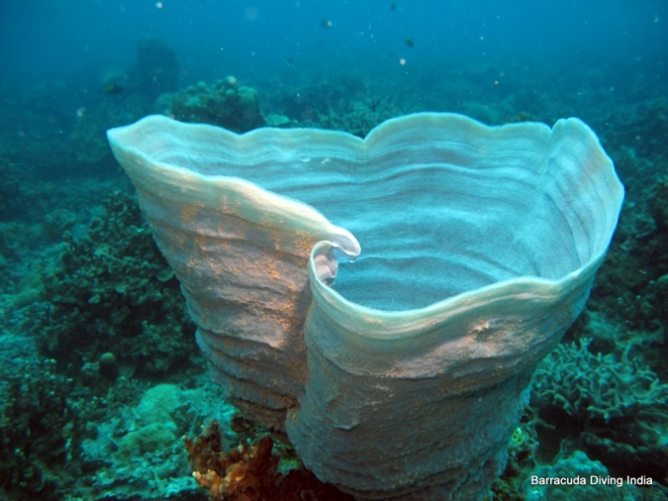
WHAT MAKES A SPONGE AN ANIMAL?
Multicellular eukaryote
Heterotrophic
No cell walls
Cell specialization

Slide 4
WHAT MAKES A SPONGE DIFFERENT THEN OTHER ANIMALS?
Sponges do not have a mouth or gut
They have no specialized tissues or organ systems
Most biologists believe sponges evolved from single-celled ancestors separately from other multicellular animals
Biologists also believe that this evolutionary line was a dead end that produced no other groups of animals

Slide 5
HOW DO SPONGES PERFORM ESSENTIAL FUNCTIONS?
The body of a sponge forms a wall around a central cavity, inside this wall are thousands of openings/pores
A current of water is powered by flagella of cells called collar cells
Water which gathers in the central cavity exits through a large hole called the osculum
The current of water delivers food and oxygen to the cells and carries away cellular waste products
Sponges are able to repair torn body parts (sieve)

Slide 6
ESSENTIAL FUNCTIONS cont’d...
Many sponges manufacture thin spiny spicules that form the skeleton of the sponge
A special cell called an amebocyte builds the spicules from either calcium carbonate (CaCO₃) or silica (SiO₂)
Some softer but stronger sponge skeletons which are used for natural bath sponges consist of fibers of a protein called spongin
Some sponges have skeletons made up of both spongin and spicules

Slide 7
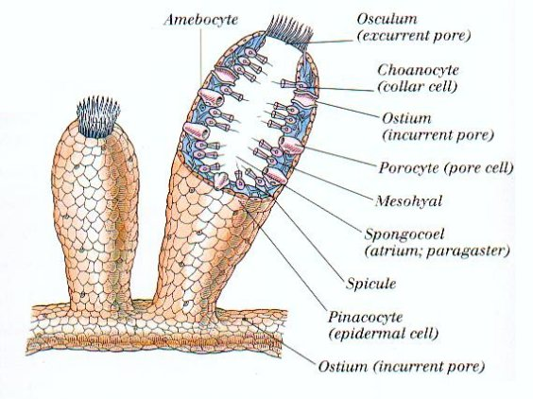
SPONGE FORM

Slide 8
FEEDING
Filter feeders: Sponges sift microscopic particles of food out of the water, the particles stick to the collar cells
Trapped particles are engulfed by the collar cells (endocytosis) and then digested, if the food is not digested in the collar cells it is sent to amebocytes which digest and transport the nutrients to the rest of the sponge
Note all digestion is intracellular (takes place inside cells)

Slide 9
RESPIRATION/INTERNAL TRANSPORT & EXCRETION
Water flowing through the sponge simultaneously serves as its respiratory, excretory and internal transport system
As water passes through the body wall, sponge cells remove O₂ from it and give off CO₂ into it
Metabolic wastes (ammonia) released into the water and carried away

Slide 10
Internal Transport – diffusion
Respiration – diffusion
Excretion – diffusion

Slide 11
REPRODUCTION
Water current also transports gametes or larvae out of the sponge’s body
Eggs are kept inside the body wall of the sponge, sperm are released into the open water
The sperm is taken out of the water by another sponge, picked up by amebocytes which transport the sperm to the eggs, where fertilization occurs
The zygote produced develops into a larva and is then released into the water where it swims and is carried by currents for a time before settling down and growing into a new sponge

Slide 12
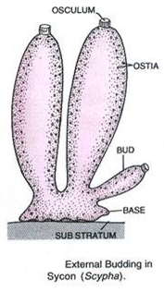
REPRODUCTION cont’d...
Sponges reproduce asexually and sexually
Gemmules are sphere shaped collections of amebocytes surrounded by spicules, they can survive long periods of freezing temperatures and drought (freshwater sponges)
When conditions are favorable again gemmules grow into new sponges
Sponges reproduce asexually by budding
Part of a sponge simply falls off the parent and grows into a new sponge

Slide 13
MOVEMENT/SPONGES AND THE WORLD
Sponges are sessile, they must protect themselves from enemies, they manufacture numerous compounds that are toxic
Researchers have found that many of these chemicals are powerful antibiotics and others act against viruses
Compounds have been useful in fighting leukemia, herpes, arthritis, strep throat
Video

Slide 14
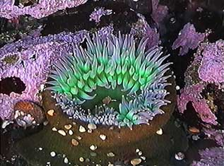
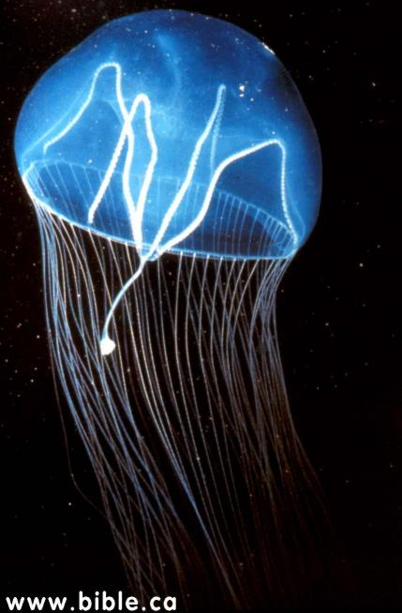
Phylum Cnidaria (ni DARE ee uh)
Like sponges, they have:
One body opening
Two cell layers
Unlike sponges:
Their cell layers are organized into tissues that have specific functions.
They have symmetry

Slide 15
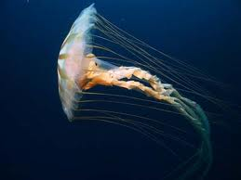
WHAT IS A CNIDARIAN?
Ex: Jellyfish, sea anemones, hydra, coral
Cnidarians are soft-bodied animals with stinging tentacles arranged in circles around their mouth
Some live as single individuals, others live in colonies
Many have two life cycles, the sessile flowerlike polyp stage and the motile bell shaped medusa stage

Slide 16
WHAT MAKES CNIDARIANS MORE EVOLVED THAN SPONGES?
All exhibit radial symmetry
All have specialized cells and tissues
In both the polyp and medusa stage a body wall exists that surrounds an internal space called the gastrovascular cavity, this is where digestion takes place
Mouth established

Slide 17
HOW DO CNIDARIANS PERFORM ESSENTIAL FUNCTIONS?
The body wall consists of three layers: epidermis, mesoglea, and gastroderm
Epidermis: layer of cells, covers outer surface
Mesoglea: Ranges from a thin membrane to a thick jellylike material with amebocytes
Gastroderm: Inner layer of cells covers surface of the gastrovascular cavity

Slide 18
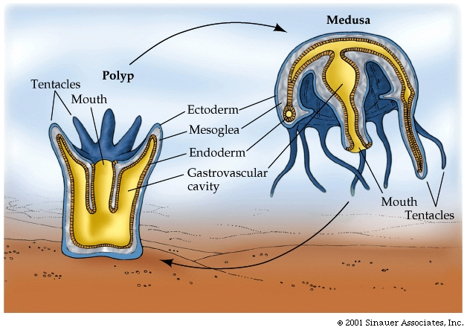
CNIDARIAN FORMS

Slide 19
Cnidarians have a primitive nervous system known as a nerve net.
These specialized cells can cause contractions of muscle-like tissue.
The movement of tentacles during prey capture is a result of these contractions.

Slide 20
FEEDING
Almost all use stinging structures called nematocysts located on their tentacles
Each nematocyst is a poison filled sac containing a “spring loaded” dart
Embeds in the skin of prey and releases paralyzing or killing levels of poison
Tentacles push food through the mouth and into the gastrovascular cavity, where food is broken up into smaller pieces
Fragments of food taken up by cells in the gastroderm that digest them further
Nutrients are then transported throughout the body by diffusion
Symbiosis with photosynthetic protists (live in cells in the gastroderm)

Slide 21
RESPIRATION/EXCRETION
Cnidarians can respire and eliminate waste products by diffusion directly through their body walls
There is no organized internal transport network or excretory system
They lack a CNS and a brain, they have simple nervous systems called nerve nets which are concentrated around the mouth
Info about the enviro. is transmitted to the rest of the nervous system by sensory cells

Slide 22
REPRODUCTION
Most can reproduce both sexually and asexually
Polyps can produce new polyps asexually by budding, a polyp begins to swell, this swelling eventually turns into a new polyp
Many polyps can also reproduce new small medusa
When medusa mature they can reproduce sexually by releasing gametes into the water
Depending on the species, fertilization occurs either in open water or inside an egg carrying medusa
The zygote grows into a ciliated larva which swims around and then settles down on a hard surface and changes into a polyp, starting the cycle again

Slide 23
CNIDARIANS AND THE WORLD
Class Hydrozoa: Hydras, lack medusa stage, move using a somersaulting movement, can be hermaphroditic
Class Scyphoza: Jellyfish, Medusa stage long-lived, polyp stage shortened to a larva stage (box jellyfish)
Class Anthozoa: Sea anemones and coral, have only polyp stage in their life cycle, corals provide shelter, jewellery, retaining wall from waves, sea anemones-symbiotic relationships with fish and other organisms

Slide 24
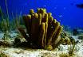
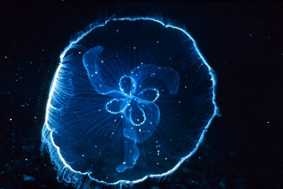
Comparison of Sponges & Cnidarians
Example
Body Plan | Asymmetrical | Radial Symmetry
Feeding/ Digestion | Filter Feeder Digestion takes place in amoeboid cells | Captures prey with nematocysts & tentacles Digestions takes place in gastrovascular cavity
Movement | Sessile | Aquatic floating or sessile
Response to Stimuli | No nervous system Cells react to stimuli | Simple nervous system consisting of nerve net
Reproduction | Sexual Asexual: Fragmentation & budding | Sexual Asexual: budding

Slide 25
HOMEWORK
Pg 697 #1-6
Pg 705 #1-5
VOCAB for ch 25 & 26
Draw the sponge on page 694, and the polyp on page 699 (label each)

