Slide 1
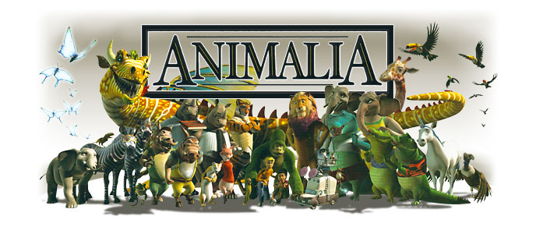
http://www.youtube.com/watch?v=F-Io7MPkYV0
Animal Bloopers
https://www.youtube.com/watch?v=VEW1CMgNvRk
Animals are awesome!

Slide 2
Extra Vocab you should know!
Division of labor
Herbivore
Carnivore
Parasite
Detritus Feeder
Filter Feeder
Larva
Anterior
Posterior
Ventral
Dorsal
Cephalization
Ganglion
Sessile
Motile
Linear Digestive System
Notochord
Coelomate
Metamorphosis
Caudal
Dioecous

Slide 4
What animals need to do to survive
To survive, animals must be able to perform a number of essential functions:
1) Feeding
2) Respiration
3) Internal Transport
4) Excretion
5) Response
6) Movement
7) Reproduction
Let’s go through one at a time.......

Slide 5
Feeding
Herbivore: eats plants: feed on roots, stems, leaves, flowers or fruits
Carnivore: eat animals: feed on herbivores and other carnivores. Will eat any part of prey-fat, muscle, bone marrow and blood
Parasite: feed either inside host or attach to outer surface of organism (do harm to host)
Filter feeders: (Many aquatic animals) Animals that strain tiny floating plants and animals from water around them
Detritus feeders: (detrivors) Feed on decaying plants and animals

Slide 6
Respiration
Living cells consume O₂ and give off CO₂ in the process of cellular respiration:
O₂ + C₆H₁₂O₆ → Energy + CO₂ + Water
All animals must respire (breathe)
Small animals that live in H₂O or in moist soil, may respire through their skin
The respiratory system of large animals has evolved to take many different forms

Slide 7
Internal Transport
Most animals need some way to carry O₂, nutrients and waste products to and from cells deep within its body
Many multicellular animals have evolved a circulatory system in which a heart pumps blood through blood vessels

Slide 8
Excretion
Cellular metabolism produces chemical waste such as ammonia that is harmful and must be eliminated
Large animals both in H₂O and on land must remove poisonous metabolic waste
This is done through the development of an excretory system that stores and disposes of waste products

Slide 9
Response
Animals must keep watch on their surroundings to find food, spot predators and I.D. others of their own kind
Animals use specialized cells called nerve cells which hook-up together and form a nervous system
Sense organs such as eyes and ears gather info from the environment by responding to light, sound, temp. and other stimuli
The brain which is the nervous systems control center, processes info and regulates how the animal should respond

Slide 10
Movement
Some animals are sessile, which means they spend their adult life attached in one spot (ex.?), but many animals are motile (move around)
To move, most animals use tissue called muscle, that generates a force by contracting
In most successful animals, muscles work with a skeleton
Insects wear their skeleton on the outside of their body, this is called an exoskeleton
Reptiles, birds and mammals have their skeleton on the inside, this is called an endoskeleton
The combination of muscle and skeleton is called a musculo-skeletal system

Slide 11
Reproduction
Animals must reproduce or their species will not survive
Many animals bear their young alive
Some animals lay eggs

Slide 12
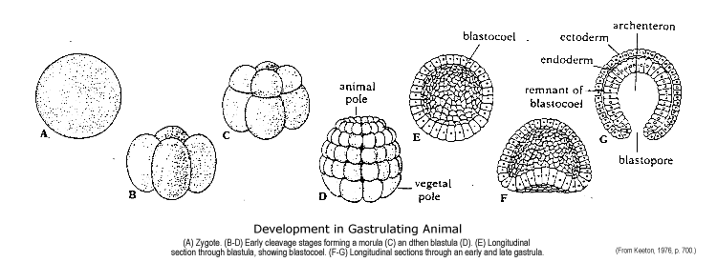
Early Development of Animals
All animals begin life as an egg cell which is fertilized by a sperm cell, the fusion of the two is called a zygote and begins to divide by the process of mitosis
As division continues, the cells form a hollow sphere called a blastula which begins to fold inwards

Slide 13
Development of animals cont’d...
The germ layers, ectoderm and endoderm will form the different tissues in the adult
Ectoderm forms on the outside of the blastula and forms skin and the nervous system, more complex animals will give to feathers, nails, hair and scales
Endoderm forms on the inside of the blastula and forms the lining of the gut
There is also a germ layer that lies between the ecto. and endoderm layers and is called the mesoderm
The mesoderm will develop the organs of the circulatory, reproduction, urinary and musculatory systems

Slide 14
The Animal Kingdom
The study of animals is known as Zoology
All animals are heterotrophic (must ingest organic substances)
The animal kingdom is broken into two broad groups; Vertebrates and Invertebrates

Slide 15
Vertebrates and Invertebrates... What is the difference?
Vertebrates have what is called a notochord; A skeletal rod of connective tissue which runs lengthwise along the dorsal surface
Invertebrates lack a notochord or backbone

Slide 16
Kingdom Animalia- The Invertebrates
General Characteristics:
Invertebrates comprise over 95% of all known species
Multicellular
Heterotrophic
No cell walls
No chlorophyll
Most have cells differentiated into tissue
Produce gametes (eggs/sperm) in multicellular organs

Slide 17
Invertebrate Phyla
Phylum Porifera= sponges
Phylum Cnidaria= hydra, jellyfish, sea anemone, coral
Phylum Platyhelminthes= flatworms, planaria, tape worm
Phylum Nematoda= unsegmented and round bodied worms
Phylum Mollusca= octopus, squid, clam, snail, slug
Phylum Annelida= earth worms, leeches, sandworms
Phylum Arthropoda= crabs, spiders, insects
Phylum Echinodermata= sea urchin, starfish, sand dollars

Slide 18
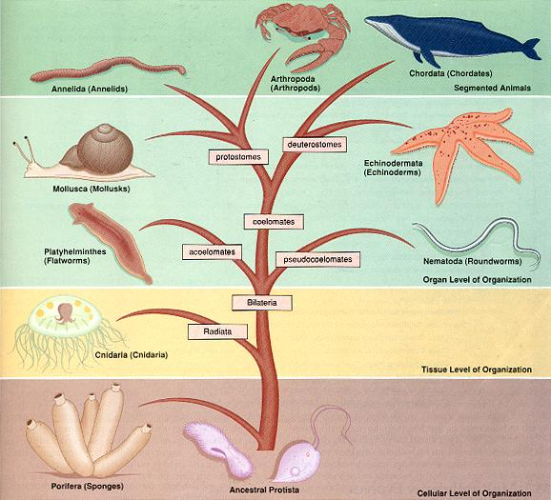

Slide 19
Cellular Level of Organization: Cell Specialization
The bodies of animals contain many types of specialized cells, each specialized cell has a shape, physical structure and chemical composition that makes it suited to perform a particular function within a multicellular organism (ie) cells for eyes, reproduction etc.
The different groups of specialized cells that carry out different tasks is known as division of labor

Slide 20
Tissue Level of Organization: Symmetry
There are two types of symmetry you will study
1) Bilateral Symmetry: Right and left halves of the organism are mirror images (ie) human, cat, dog
2) Radial symmetry: Symmetrical around a central axis (ie) starfish and sea urchins
Anterior/Posterior
Dorsal/Ventral

Slide 21
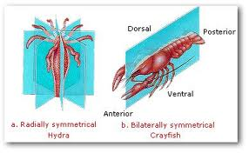

Slide 22
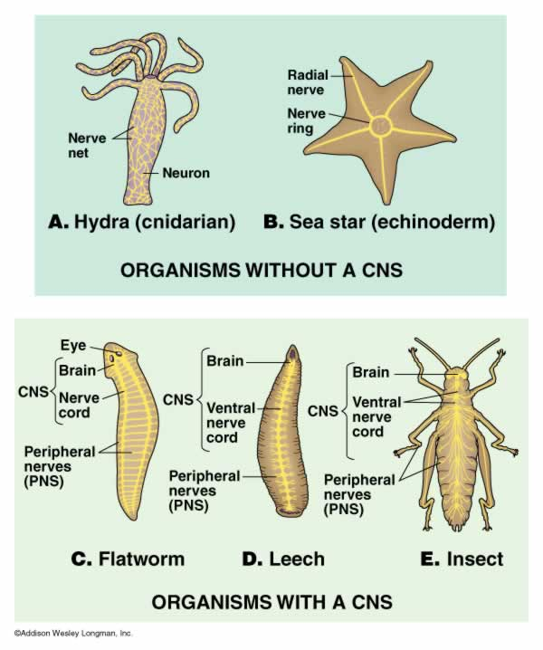
Increasing Cephalization
Cephalization: gathering of sense organs and nerve cells into the head region (head first)

Slide 23
Organ Level of Organization: Body Cavities
Animals have cells specialized for digestion
Some simple animals form a gut with a single opening which acts as both a mouth and an anus This is known as a blind digestive system
Complex animals have a gut with two openings, a mouth and an anus so that movement functions in one direction. This is called a linear digestive system

Slide 24
Segmented Animals
Annelida, Arthropoda, Chordata
The many segments of an annelids body are separated by septa
Some segments are modified to perform special functions
What would be a benefit of having a segmented body?
Notes:
What would be a benefit of having a segmented body? Easier movement and regeneration.

Slide 25
What have we learned?
Name the 7 essential animal functions
Describe the process of the development of animals
Name the three germ layers and one thing they each give rise to
Name the 9 different animal phyla in order from least to most complex and one example from each
Name 3 different specializations of animal cells starting from least to most complex
Go through chapter 26 and research porifera and cnidarians. Find out how they perform each of the 7 essential life functions, give one specie example from each and explain what makes them different from the phyla level below it.

Slide 26
What makes me different?
Go through chapter 26 and research porifera and cnidarians. Find out how they perform each of the 7 essential life functions, give one specie example from each and explain what makes them different from the phyla level below it.

