Slide 1
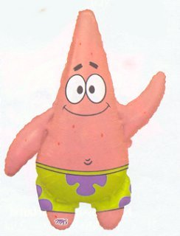
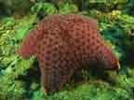
Echinoderms

Slide 2
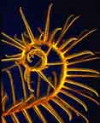
General Characteristics
Spiny skin
5-part radial symmetry
Internal skeleton
Tube feet

Slide 3
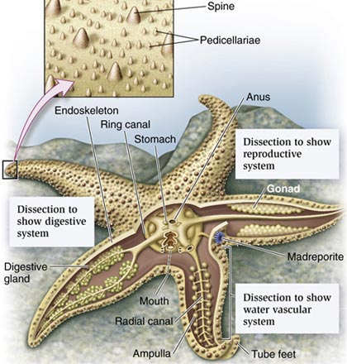
Notes:
Water vascular system = movements of water → move tube feet/arms; remove waste/respiration/circulation

Slide 4
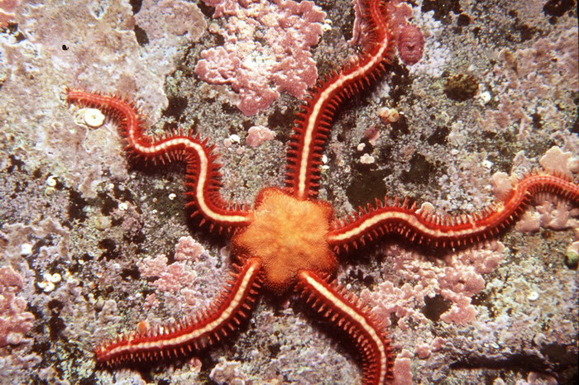
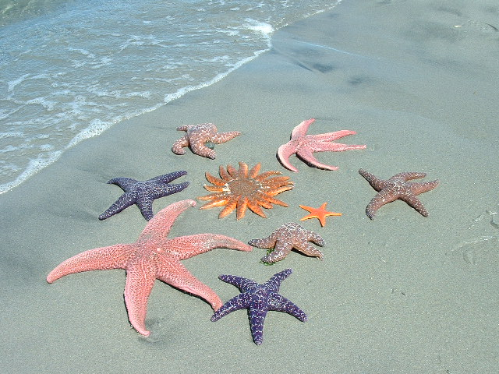
Examples
Sea Stars, Brittle Stars

Slide 5
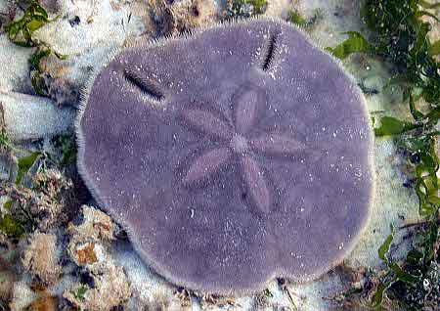
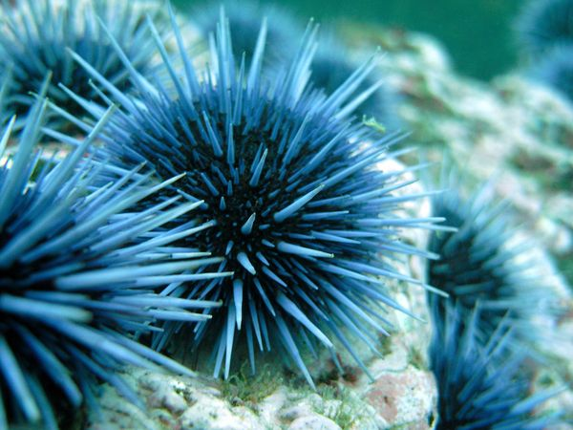
Examples
Sea Urchins, Sand Dollars

Slide 6
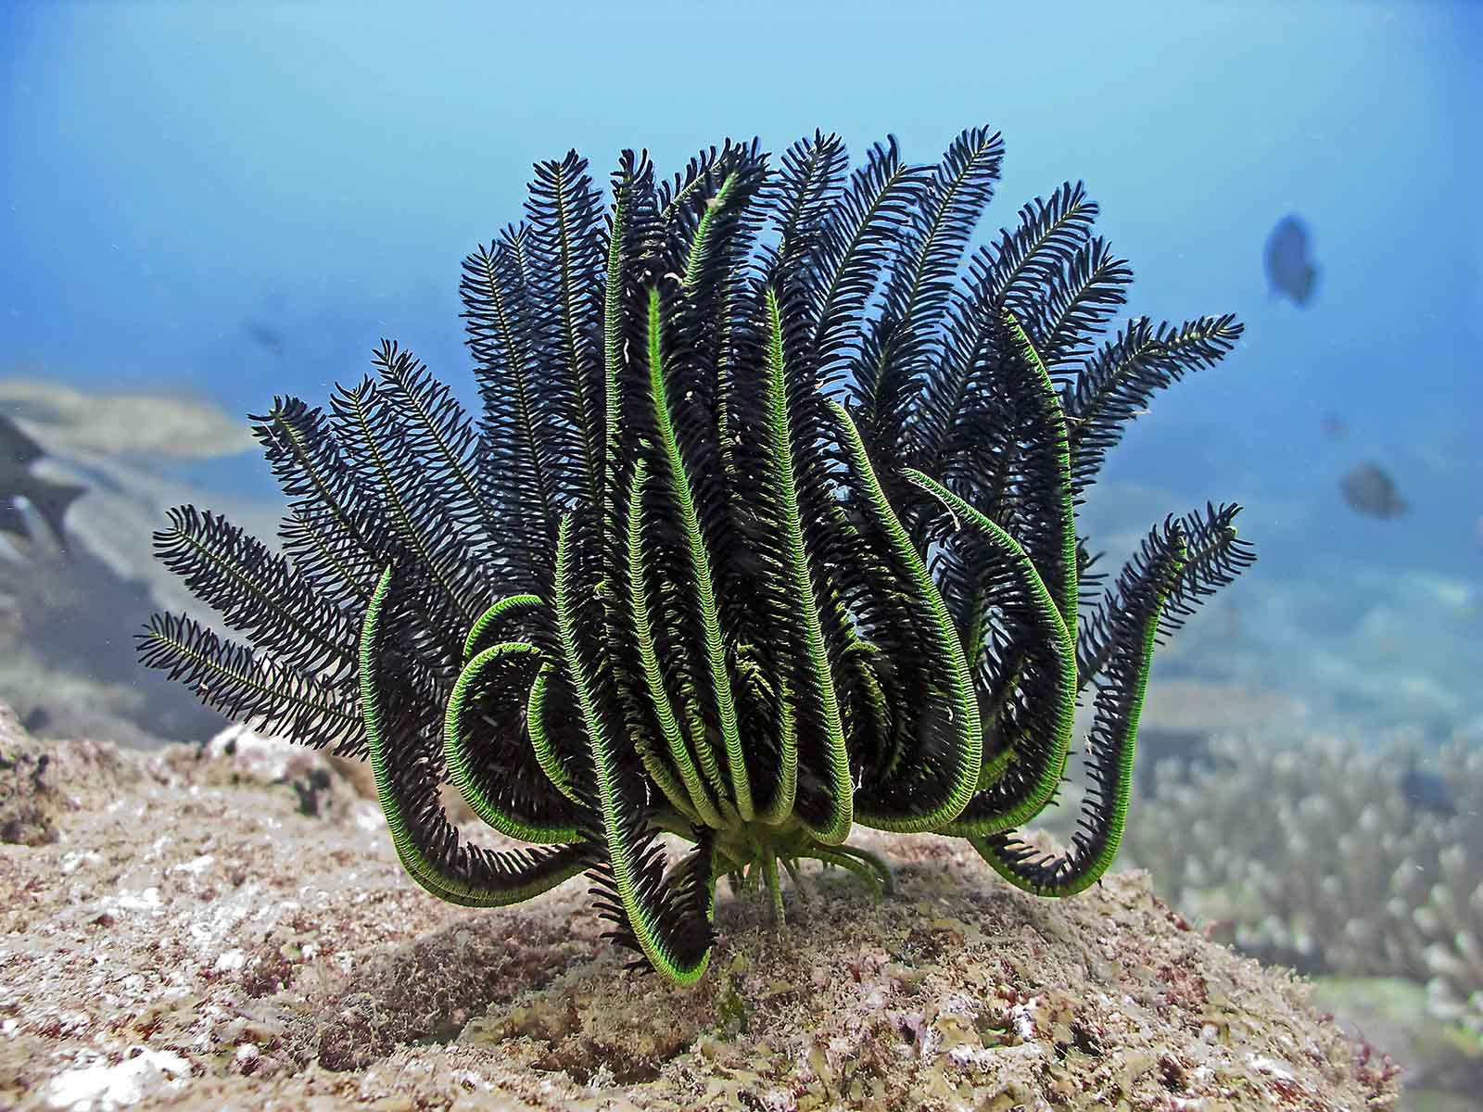
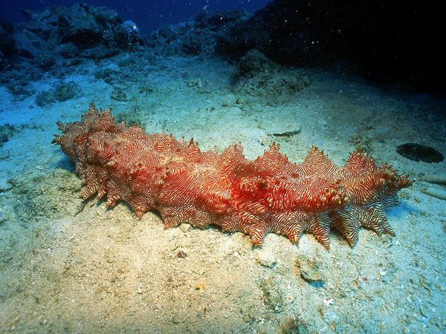
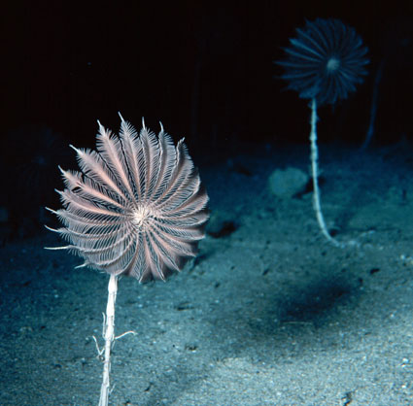
Examples
Sea Cucumbers, Sea Lilies, Feather Stars

Slide 7
Feeding
Use tube feet to pry/grasp
Stomach pushed out through mouth → pours out digestive enzymes → pulls in nutrients and partially digested prey
https://www.youtube.com/watch?v=2DFXGafpGkQ

Slide 8
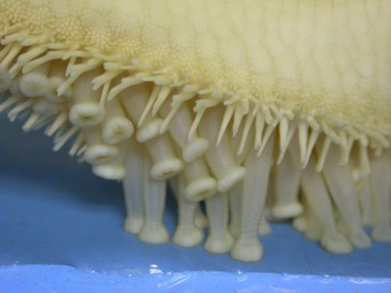
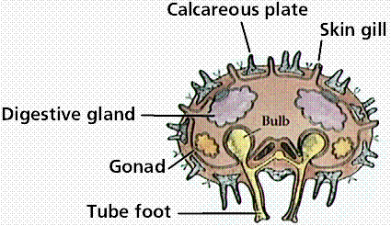
Respiration
Tube feet or skin gills

Slide 9
Internal Tranport
May use water system integrally
None; relies on other systems and/or diffusion through skin

Slide 10
Excretion
Solid waste → anus
Cellular waste → tube feet or skin gills

Slide 11
Response
No brain
Nerve ring
Sensory cells

Slide 12
Movement
Tube feet help crawl/pull
Muscle fibres attach to endoskeleton plates
Sand dollars, urchins much less movement because of fused plates
Sea cucumbers have no plates

Slide 13
Reproduction
Most have separate sexes
External fertilization
Starfish can regenerate, when sectioned/severed

Slide 14
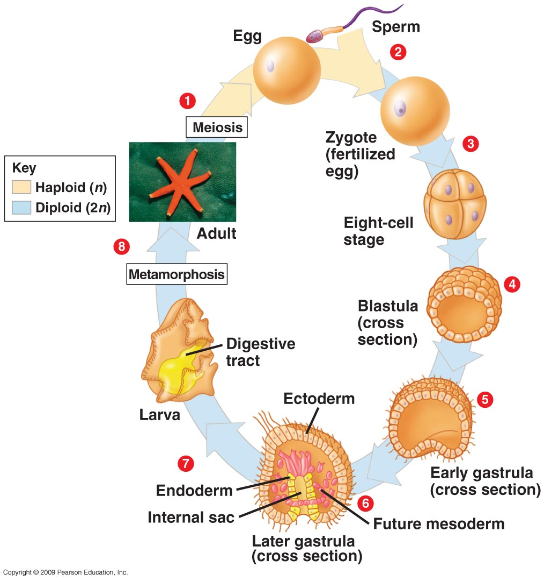
Life History
Notes:
Adult; external fert; zygote; larva; metamorph; adult

