Slide 1
Arthropods
General Characteristics (Day 1)
Notes:
https://www.youtube.com/watch?v=Q1zbgd6xpGQ

Slide 2
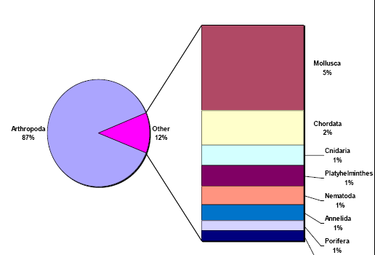

Slide 3
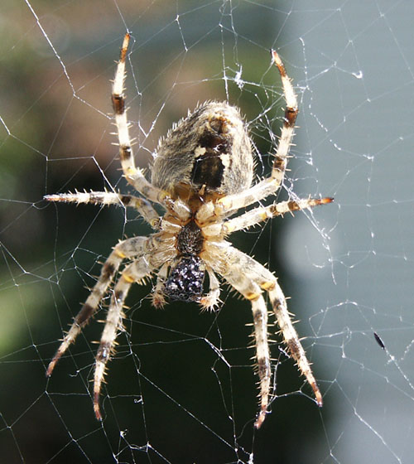
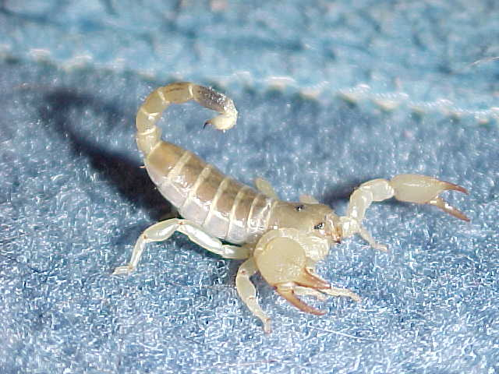
General Characteristics
Insects, spiders, crustaceans
“jointed food” – all have jointed appendages
Segmented body
Exoskeleton

Slide 4
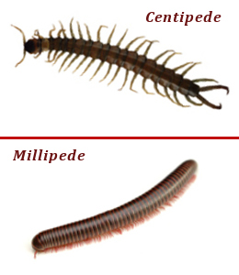
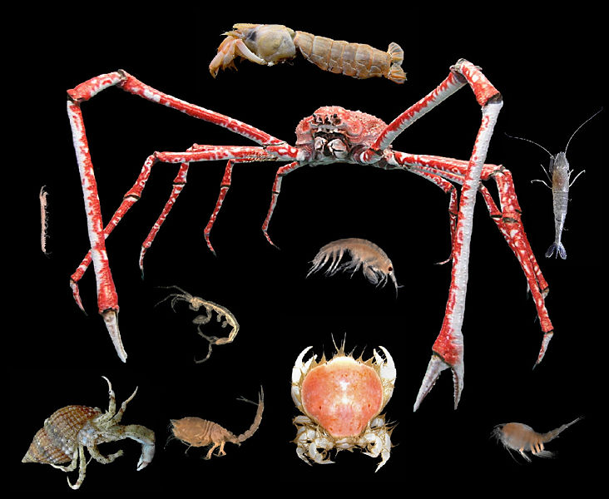
General Characteristics
Open circulation
Compound eyes
Special tubes for excretion, and respiration

Slide 5
Exoskeleton
Made of carbohydrates
Protection, water proofing
Does not grow with animal – must be shed and regrown
Blue Crab Molting

Slide 6
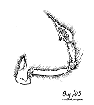
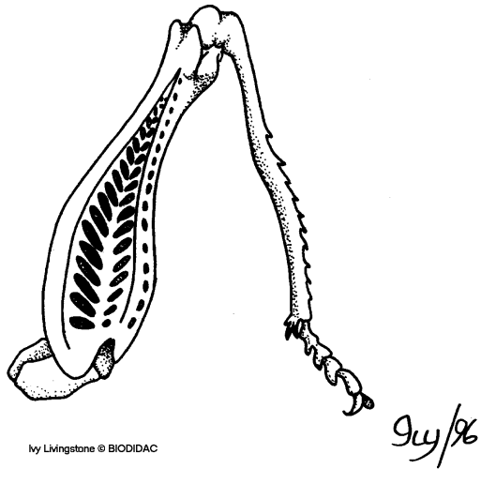
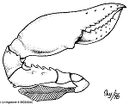
Jointed Appendages
Specialized features, may have many different types of appendages on one body
Most have small muscles, for movement
Notes:
Antennae
Claws
Walking legs
Wings
Flippers
Other specialized features

Slide 7
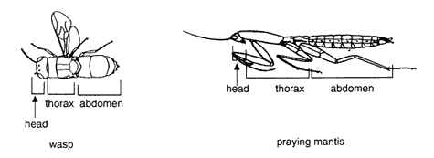
Segmentation
Most adults have fused segments
Head, thorax, abdomen
Some might have fused head, thorax: “cephalothorax”

Slide 8
Respiration
Land: Using spiracles and trachea – holes along the side of the body for gas exchange
Aquatic: Gills/book gills (Video)

Slide 9
Excretion
Solids, others via anus
Cellular Waste:
Malpighian tubules – terrestrial
Diffusion – aquatic
Green gland – aquatic (lobsters etc)
(video)

Slide 10
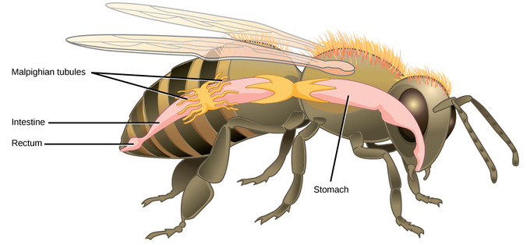

Slide 11
Internal Transport
Open Circ
One long, narrow heart along abdomen
Pumps blood through arteries into tissues
Tissues empty waste blood into sinuses…eventually all collects back into large cavity…back to heart

Slide 12
Response
Well developed
Brain = pair of ganglia
Compound eyes
Sense organs (statocycts, chemo receptors, sensory hairs)

Slide 13
Movement
Coordinated nervous and muscle system
Muscles at exoskeleton joints

Slide 14
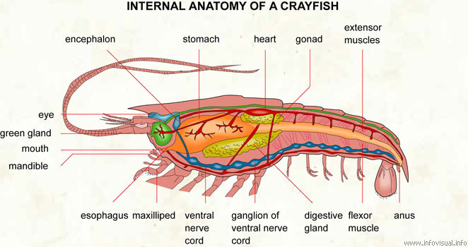

Slide 15
Reproduction
Separate sexes
Most is internal fertilization
Most lay eggs
Most development has some form of metamorphosis – major change in body form
Horseshoe laying eggs
Dragonfly metamorphosis

Slide 18
To Do’s
Groups – Questions & Colouring Sheet!
Dictionary
exoskeleton, green gland, tracheal tube, malpighian tubule, metamorphosis

Slide 19
Questions
What are appendages? Why are they important?
Name at least 3 reasons the exoskeleton is important for arthropods
Why do appendages need to be jointed?
What are at least 2 differences between aquatic and terrestrial arthropods? Why do you think there ARE differences?

Slide 20
Arthropods
Types & Examples

Slide 21
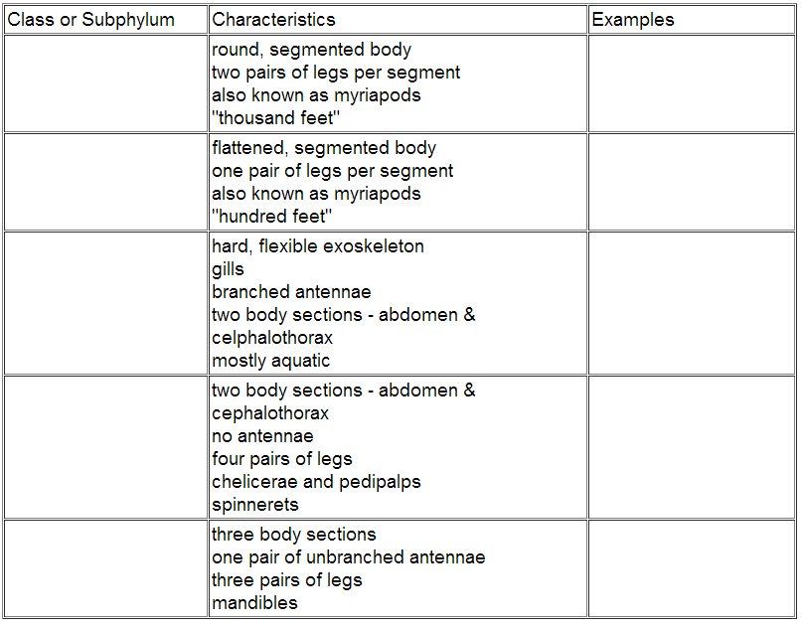

Slide 22
Uniramia
(Class Diplopoda)
Uniramia
(Class Chilopoda)
Crustacea
Uniramia
(Class Insecta)
Cheliceratea
(Class Arachnida)

Slide 23
round, segmented body two pairs of legs per segment also known as myriapods "thousand feet“
flattened, segmented body one pair of legs per segment also known as myriapods "hundred feet"

Slide 24
hard, flexible exoskeleton gills branched antennae two body sections - abdomen & celphalothorax mostly aquatic
two body sections - abdomen & cephalothorax no antennae four pairs of legs chelicerae and pedipalps spinnerets

Slide 25
hard, flexible exoskelton
gills
branched antennae
abdomen & cehalothorax

Slide 26
two body section - abdomen, cephalothorax
NO antennae
four pairs of legs

Slide 27
three body sections one pair of unbranched antennae three pairs of legs mandibles

Slide 28
Arthropods Pictures

Slide 29
Arachnids

Slide 31
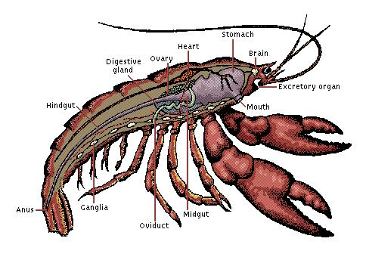
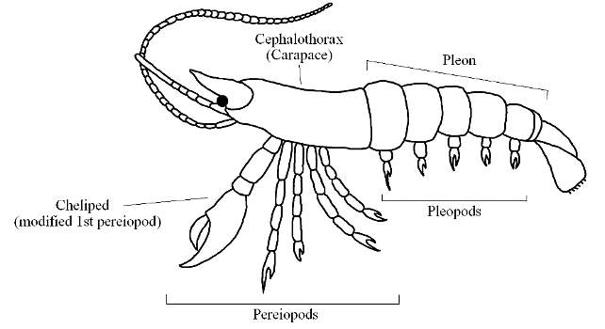
Crustaceans

Slide 32
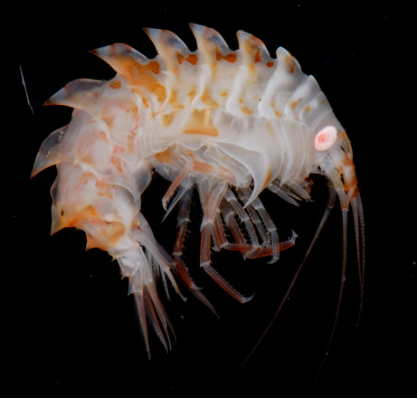
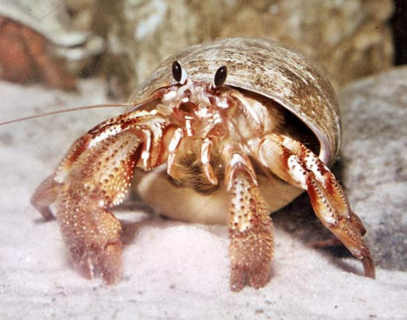

Slide 34
Insect

Slide 37
To Do’s
Chart [left]
Questions [right]
Pre-lab (grasshopper or crayfish)

