Slide 1
Population Genetics
Population Genetics = The study of all
the genetic traits in a population
Gene Pool = combined genetic makeup
all the members of a population

Slide 2
Genetic Equilibrium
A constant state of allele frequency
Population not evolving
Allele frequencies remain stable
This situation is also known as the:
HARDY-WEINBERG PRINCIPLE

Slide 3
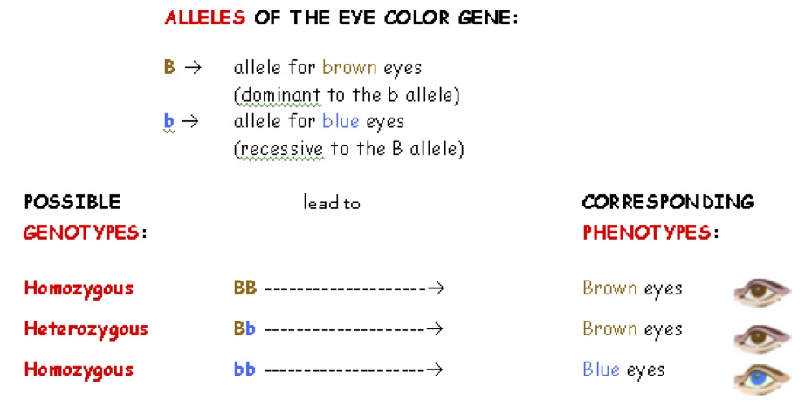

Slide 4
Conditions required to maintain genetic equilibrium:
No natural selection – all alleles must be equally favorable
Random mating
No migration – no new alleles brought into population
No significant mutations – mutations would bring new alleles into population
NOTE: Evolution is a result of disruption in genetic equilibrium

Slide 5
4 Ways to Disrupt Genetic Equilibrium
Mutation: introducing new alleles into a population
Genetic Drift
Gene Flow
Natural Selection: acting on variations
Directional selection
Stabilizing selection
Disruptive selection

Slide 6
Genetic Drift
Natural selection (AKA - survival of the fittest), is not the only source of evolutionary change.
In small populations, an allele can become more or less common simply by chance.
This kind of random change in allele frequency is known as GENETIC DRIFT .
Because of genetic drift, a particular gene, just by chance, can become common in a population. (ie) blue eyes in humans.

Slide 7
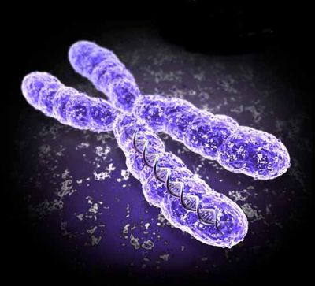
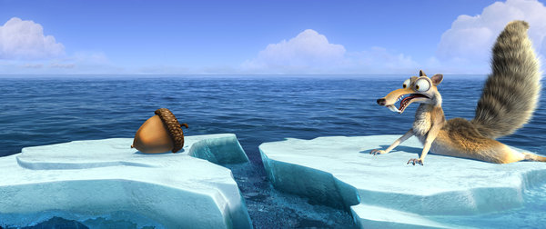
Genetic Drift

Slide 8
Genetic Drift Simulation
STEP 1: Colour the worms in generation 0 each a different colour

Slide 9
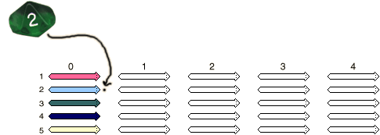
Genetic Drift Simulation
STEP 2: Roll the die and put a dot next to the corresponding worm
If you roll a 6, ignore it and roll again

Slide 10
Genetic Drift simulation
STEP 3: Repeat step 2 until you’ve rolled 5 numbers and have drawn 5 dots

Slide 11
Genetic Drift Simulation
STEP 4: Starting at the bottom, draw a line from each dot to the bottom-most worm in generation 1.
STEP 5: Colour the worms in the next generation the same colour as their parents

Slide 12
Genetic Drift Simulation
Repeat steps 2-5 until all the worms in a generation are the same colour

Slide 13
What do you think?
What do you notice, after a few generations?
If you did it again, did you get the exact same result?
What would happen to your population, if you had a “new” colour appear at the end?
What effect does population size have?
Notes:
What happened to the variation in your population, over many generations?
Was it only the “good” traits that were passed on, or was there some randomness involved?
How many generations did it take?
What would happen if we doubled the population size? http://www.biology.arizona.edu/evolution/act/drift/frame.html

Slide 14
Genetic Drift (write!)
The change in the frequency of a trait in a population, by chance events
Over time, one trait may become frequent (almost!) 100% of the time, and other traits may disappear from a population altogether
Has a bigger effect, in smaller populations

Slide 15
Gene Flow (write!)
“the transport of genes through migration”
If an individual leaves a population, their genes go with them!
When entering a new population, could introduce new genes!

Slide 16
(write!)
Genetic Drift
Gene Flow
Within one population, changing frequency of genes
Typically reduces diversity
Movement of genes from one population to another
Both: could change a population, over many generations! (aka. Evolution!!!)

Slide 17
Selection and Distribution
There are 3 types of selection that we can observe in different populations:
1.Directional Selection
2.Disruptive Selection
3.Stabilizing Selection

Slide 18
Normal distribution
Imagine this graph represents coat color of a population
In a normal distribution curve there is a greater number of individuals that are in the middle of the curve – medium coat color
There are fewer at the extremes – light & dark

Slide 19
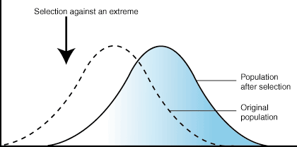
1. Directional Selection
the environmental conditions favor individuals of one
Extreme (steady trend)
the curve shifts to the right (ex. Dark colors are favoured) or to the left (ex.light colors are favoured)

Slide 20
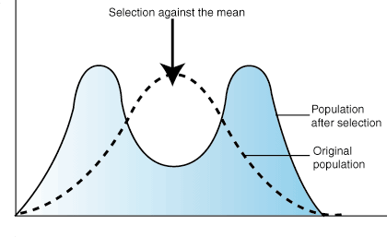
2. Disruptive Selection
selection against the middle of the normal distribution curve favors variants of opposite extremes
Ex. Medium color is no longer favorable both light and dark colors are favored

Slide 21
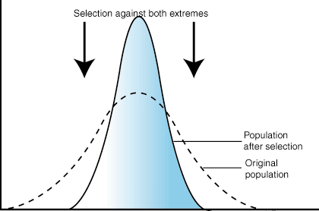
3. Stabilizing Selection
the conditions of the environment remain stable for a long period of time
selection is against the extremes and favors the intermediate
Ex. The medium color is favored (video-8:17)

