Slide 1
Evidence of Evolution
1.The fossil record
2. Geographic Distribution of Living species
3. Homologous Body structures
4. Similarity in Embryology

Slide 2
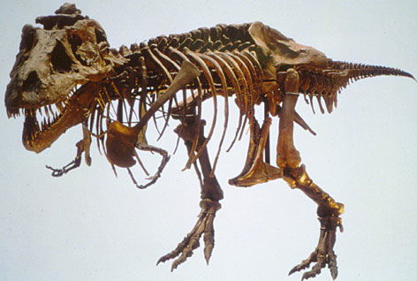
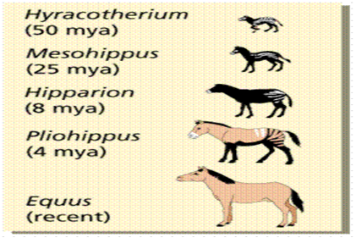
1.Fossil Record
The fossil record – provides evidence that living things have been evolving for millions of years.

Slide 3
2. Geographic Distribution of Living Species
Similar environments on different continents that have different animals, however, the different animals have similar anatomies and behaviors.
-species living on different continents had each descended from a common ancestor
-however, some animals on each continent were living under similar ecological conditions, they faced similar pressures of natural selection
-because these animals faced similar pressures of natural selection, different animals ended up evolving certain striking features in common.

Slide 4
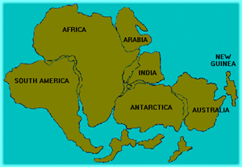
Animals found on islands often resemble animals on the nearby continent. In other words, island species evolved from mainland migrants.
Fossils of the same species can be found on the coastline of neighbouring continents. As we know, the continents drift.
Closely related species are almost never found in exactly the same location or habitat.
Pangea →

Slide 5
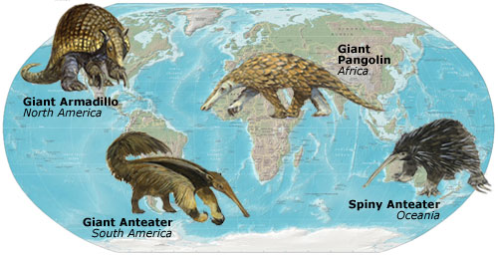
Geographic Distribution of Living Species

Slide 6
3. Homologous Body Structures
- similar anatomical structures that vary in function.
Eg. Limbs of birds, mammals, and reptiles vary greatly in form and function but are constructed from the same basic bones

Slide 7
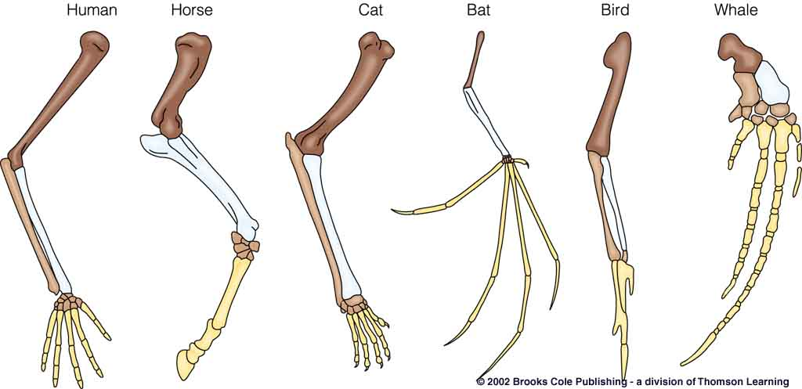
Homologous structures Video 1:09

Slide 8
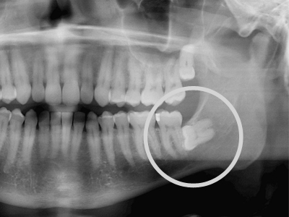

Slide 9
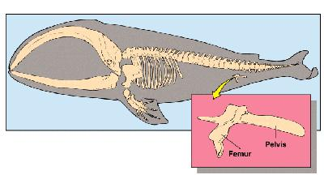
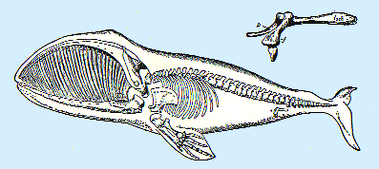
Vestigal Organs
-Vestigal organs- organs reduced in size that they are just traces of homologous structures in other species. Eg. Appendix in humans, hind limbs
“Evolutionary left overs”
No useful purpose/function

Slide 10
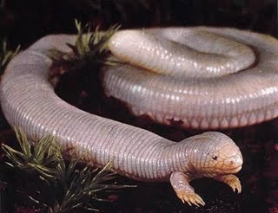
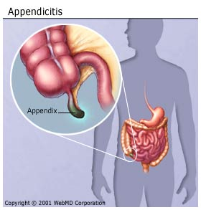
Vestiges Examples
Snakes-evolved from 4 legged creatures; some snakes have tiny leg bones but no longer function for walking
Humans: appendix has no function; koala appendix helps them to digests plants
Humans: tail bone; male nipples; goose bumps; wisdom teeth
Notes:
livescience.com/21513-vestigial-organs.html

Slide 11
4. Similarities in Embryology
the early stages, or embryos, of many animals with backbones are very similar. Same groups of embryonic cells develop in the same order and in similar patterns to produce tissues and organs of all vertebrates
Embryos of different organisms exhibit SIMILAR STAGES of embryonic development
The similarities between embryos in related groups (e.g. vertebrates) suggest the groups shared a common ancestral origin.
Similar genes (which lay down the basic body plan) are at work

Slide 12
