Slide 1
Specialized Tissues in Plants

Slide 2
Three principle organs of seed plants
Roots – Function?
Stems – Function?
Leaves – Function?

Slide 3
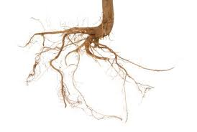
Roots
absorb water and dissolved nutrients
transports water and nutrients to rest of plant
anchor plants to ground, holding soil in place, preventing erosion
protect from harmful soil bacteria, and fungi
holds plant upright against forces such as wind, rain

Slide 4
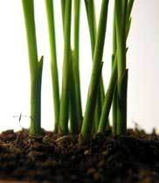
Stems
support system for plant body
transport system that carries nutrients
defense system that protects the plant against predators and disease
can vary from few millimeters to 100 metres
must be strong enough to hold up leaves and branches
stems transport system must lift water from roots to leaves and carry photosynthesis products from leaves back to roots.

Slide 5
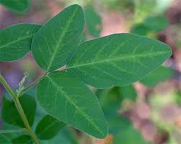
Leaves
Plants main photosynthetic systems
broad flat, surfaces help to increase sunlight absorption
exposed to a lot of dryness in air, so they must contain systems that protect against water loss
adjustable pores help conserve water while letting O2 and CO2 enter and exit.

Slide 6
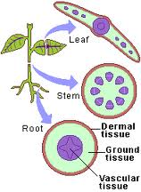
Plant Tissue System
3 main tissue systems
Dermal Tissue
Vascular Tissue
Ground Tissue

Slide 7
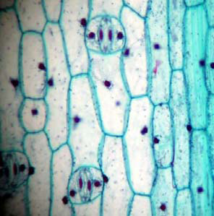
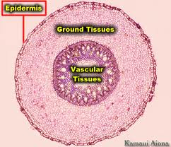
Dermal Tissue
Outer covering
Consists of a single layer of epidermal cells.
Outer surfaces are covered in a thick waxy layer called the cuticle.
Protects against water loss and injury.
Some epidermal cells have tiny projections called trichomes
Help protect, and give fuzzy appearance.
In roots- provide large amount of surface area, and aid in water absorption.
Underside of leaves- dermal tissue contains guard cells.

Slide 8
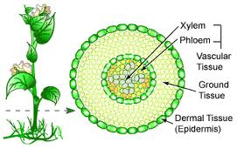
Vascular Tissue
Forms a transport system that moves water and nutrients throughout the plant.
Subsystems
Xylem
Phloem

Slide 9
Xylem
All seeds plants have a type of xylem called a tracheid.
Tracheids are long narrow cells with walls that are impermeable to water.
Pierced by openings connecting cells
When mature they die and their cytoplasm disintegrates
Angiosperms have another type of xylem called a vessel element
Vessels elements are much wider
Mature and die before they conduct water
They stack on top of each other and when they die the cell walls are lost and all the vessel elements make one continuous tube to have water move freely through.

Slide 10
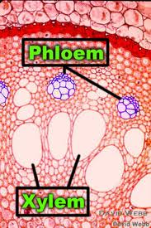
Phloem
Main cells called sieve tube elements.
arranged end to end like vessel elements.
end walls have many small holes that allow materials to move through.
Companion cells are phloem cells that surround sieve tube elements.
support phloem cells and aid in the movement of substances in and out of phloem.

Slide 11
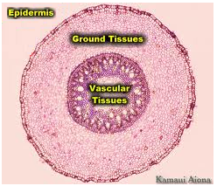
Ground Tissue
Cells that lie between dermal and vascular tissues
Has 3 different types of tissues
Parenchyma
Collenchyma
Sclerenchyma
In most plants ground tissue consists of mainly parenchyma

Slide 12
Parenchyma
Cells have thin cell walls and large ventral vacuoles surrounded by layer of cytoplasm
In leaves- these cells are packed with chloroplasts a are site of most of a plants photosynthesis.
Example-epidermal cells are living, flattened parenchyma cells.

Slide 13
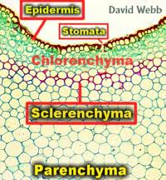
Collenchyma & Sclerenchyma
Both have thicker cell walls
Collenchyma cells have strong, flexible cell walls that help support larger plants
Makes up the familiar “strings” in celery
Sclerenchyma cells have extremely thick,
rigid cell walls that make ground tissue
tough and strong.

Slide 14
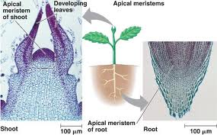
Plant Growth
Indeterminate growth- the plant grows and produces new cells at the tip of their roots and stems for as long as they live.
These cells are produced in meristems, clusters of tissue that are responsible for continuing growth.
The new cells produced in the meristematic tissue are undifferentiated, meaning they are not specialized yet.
Meristematic tissue is only tissue that produces new cells by mitosis.
Near end or tip of stem or root is an apical meristem, a group of undifferentiated cells that divide and increase the length of stems and roots.
Differentiation- when the cells that are undifferentiated divide rapidly and mature and get a specialized structure and function.

Slide 15
Review Questions:
What are the 3 main organs of a seed plant?
What are the 3 tissue systems of plants?
Some epidermal cells have tiny projections called what?
What are the two sub systems of vascular tissue?
Which ground tissue has flexible cell walls?

Slide 18
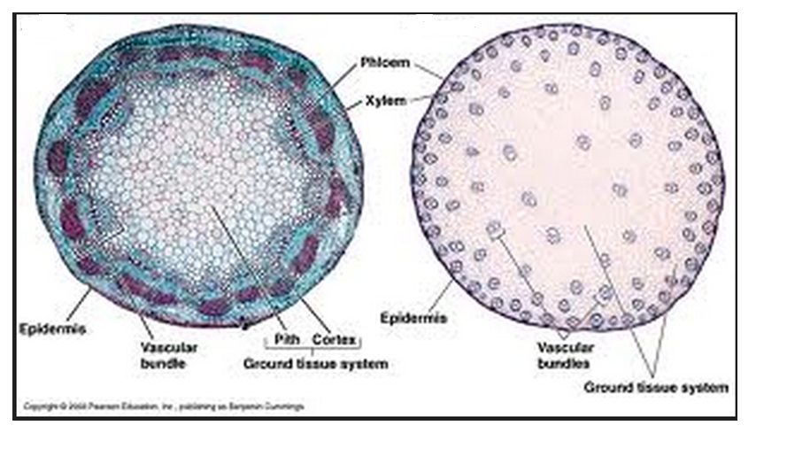
Which is monocot and dicot????

Slide 19
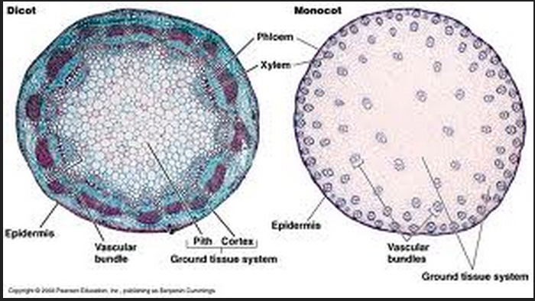

Slide 20
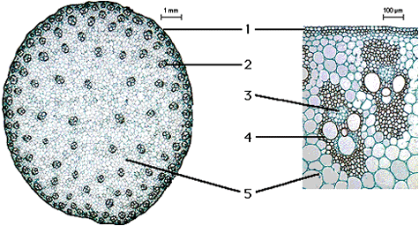
Label:
Ground tissue Dermal tissue (epidermis)
Vascular bundles Xylem
Phloem

Slide 21
