Slide 1
Nematoda
Notes:
Might be a little long for 1 page

Slide 2
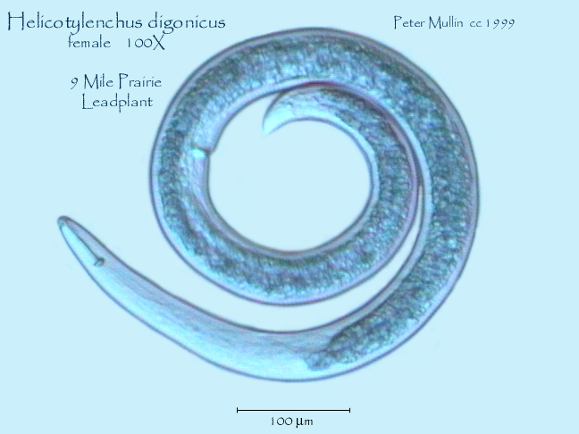
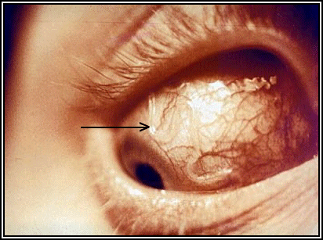
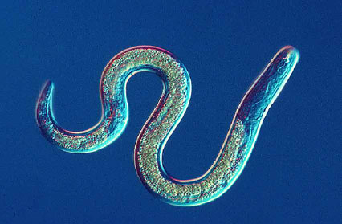
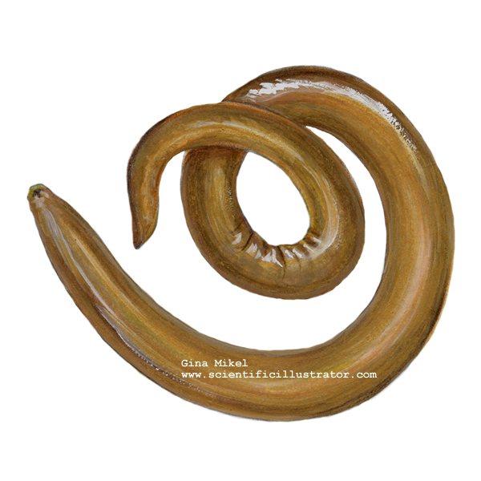

Slide 3
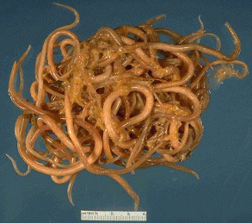
General Characters
2 openings! [digestive tract]
Round
Free-living & parasitic

Slide 4
Structure

Slide 5
Feeding
Mouth → stomach → intestine → anus

Slide 6
Ascaris
https://www.youtube.com/watch?v=4p0kC1Q3iOE
Parasitic hook worm; uncommon in N. America today
Eggs transmitted in feces of infected people → poor hygiene or used for fertilizer → ingestion → infection
Symptoms: abdominal discomfort, some nutritional deficiency
Cure: medication
Notes:
An estimated 807-1,221 million people in the world are infected with Ascaris lumbricoides(sometimes called just "Ascaris"). Ascaris, hookworm, and whipworm are known as soil-transmitted helminths (parasitic worms). Together, they account for a major burden of disease worldwide. Ascariasis is now uncommon in the United States.
Ascaris lives in the intestine and Ascaris eggs are passed in the feces of infected persons. If the infected person defecates outside (near bushes, in a garden, or field) or if the feces of an infected person are used as fertilizer, eggs are deposited on soil. They can then mature into a form that is infective. Ascariasis is caused by ingesting eggs. This can happen when hands or fingers that have contaminated dirt on them are put in the mouth or by consuming vegetables or fruits that have not been carefully cooked, washed or peeled.
People infected with Ascaris often show no symptoms. If symptoms do occur they can be light and include abdominal discomfort. Heavy infections can cause intestinal blockage and impair growth in children. Other symptoms such as cough are due to migration of the worms through the body. Ascariasis is treatable with medication prescribed by your health care provider.

Slide 7
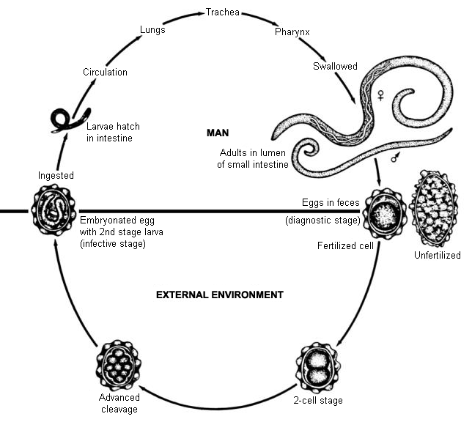
Ascaris Life History

Slide 8
Filarial Worms - Elephantiasis
Video
Notes:
https://www.youtube.com/watch?v=mQ3dBGwIYSM
https://www.youtube.com/watch?v=nkEkDHOQTLs

Slide 9
Questions
How are flatworms and roundworms different? The same?
Do you expect free-living round worms to be more or less complicated than parasitic worms. Why?
There are many parasitic round worms. Why do you think they have similar symptoms (abdominal pain, digestive properties)

