Slide 1
The Levels Of Classification
And The Six Kingdom System

Slide 2
After naming organisms, Linnaeus grouped them together according to the body structures they shared.
Organisms that shared important characteristics were classified in the same group. These groups are called taxa (singular: taxon).

Slide 3
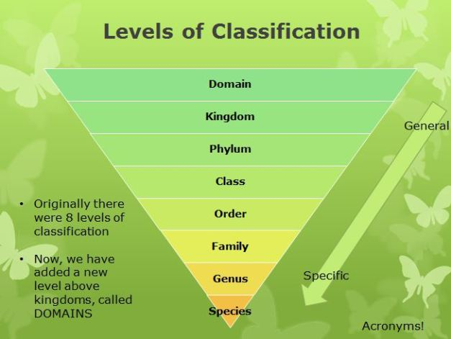

Slide 4
The smallest taxon is the species, which is defined as a population of organisms that share similar characteristics and can breed with each other.
Genus is the next largest taxon. All the various species within the same genus have many common characteristics.

Slide 5
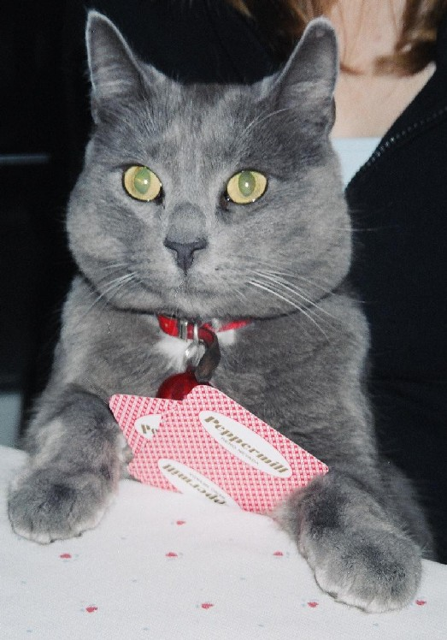
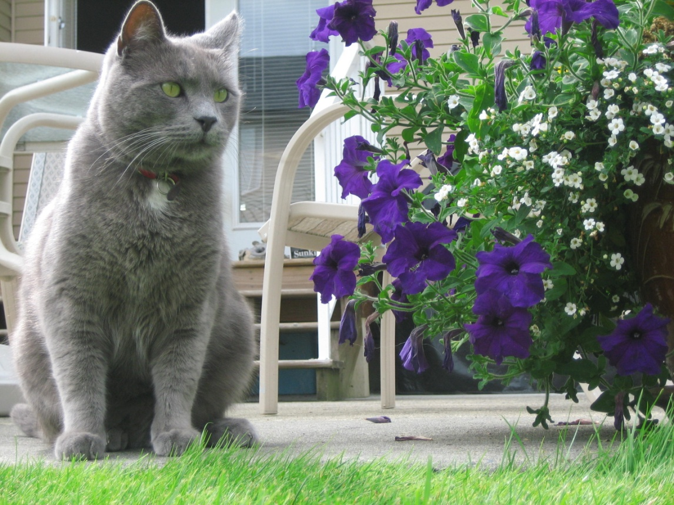
(ie) The common housecat is named Felis domesticus. The genus to which the housecat belongs, contains other species, such as a cougar, Felis concolor. All members of the genus Felis all have similar teeth, feet, and claws.

Slide 6
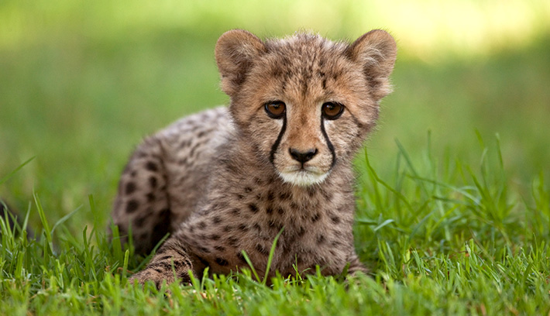
There are other catlike animals that are different enough from those in the genus Felis that are placed in a different genera. Lions and tigers belong to the genus Panthera. And cheetahs, although similar to lions, belong to the genus Acinonyx. Groups of genera such as these, which share common characteristics are gathered into larger units called Families.

Slide 7
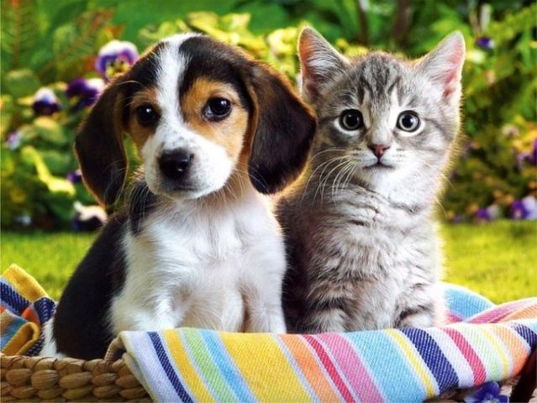
Several families make up the next taxon called an order. (ie) cats (family Felidae) and dogs (family Canidae) are from the same order – carnivora. All members of this order are carnivores (meat-eaters).

Slide 8
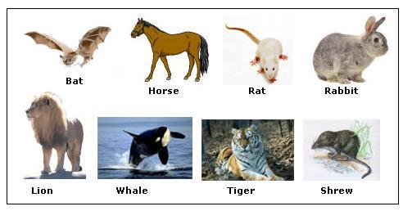
Orders are grouped into classes. All members of the order carnivora are warm blooded, have body hair, and produce milk for their young. For these reasons, they are placed with humans and other animals in the class mammalia.

Slide 9
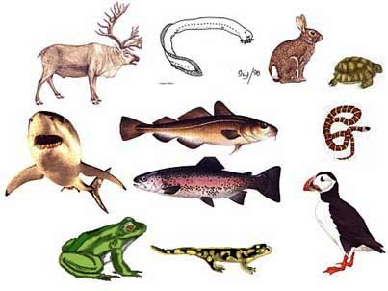
Several classes are placed in a phylum which includes a large number of very different organisms that share important basic characteristics. (ie) mammals, birds, fish, and reptiles are placed into the phylum chordata.

Slide 10
Linnaeus’ phylas belong in one of two giant taxa called kingdoms. Animals form the kingdom Animalia and plants form the kingdom Plantae.
All kingdoms can be placed into one of three Domains. Eukaria, Bacteria and Archaea

Slide 13
The Linnaean classification system looks like this:
Domain
Kingdom
Phylum
Class
Order
Family
Genus
Species

Slide 14
A Way To Remember
Dumb Domain
Kings Kingdom
Play Phylum
Chess Class
On Order
Funny Family
Glass Genus
Squares Species
Notes:
Gretzy scores

Slide 15
For hockey fans
Don’t
Kings
Play
Calgary
On
Friday?
Gretzky
Scores

Slide 16
The Six Kingdom System
Linnaeus created his taxa in the 18th century. However, his two kingdom system was not efficient enough to include all organisms.
As a result of discoveries of new life forms and changing ideas, the most generally accepted classification system contains six kingdoms.

Slide 17
The six kingdoms are
Kingdom Animalia
Kingdom Plantae
Kingdom Fungi
Kingdom Protista
Kingdom Eubacteria
Kingdom Archaebacteria

Slide 19
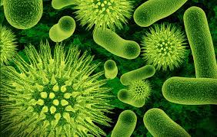
The Kingdoms Eubacteria and Archaebacteria contain all prokaryotes which are single celled organisms whose cells do not have a nucleus. (ie) Bacteria
Eubacteria video
Archaebacteria video

Slide 20
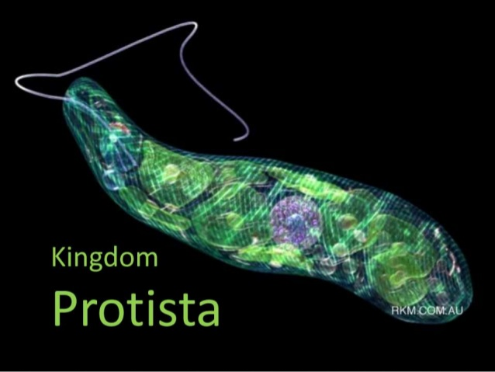
The Kingdom Protista contain all the single celled eukaryotes organisms. These organisms differ from prokaryotes because they possess a nucleus and membrane bound organelles.
Video

Slide 21
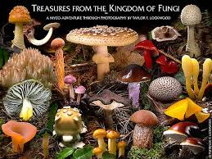
Members of the Kingdom Fungi build cell walls that do not contain cellulose. Fungi are heterotrophic. (do not carry on photosynthesis)
video

Slide 22
Members of the Kingdom Plantae are multicellular, have cell walls that contain cellulose, and are autotrophic (carry on photosynthesis using chlorophyll).
video

Slide 23
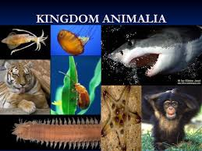
The members of the Kingdom Animalia are multicellular, heterotrophic, and have cells with a cell membrane and lack a cell wall.
Video

Slide 24
Questions
What is a trait shared by all members of the order carnivore?
Which traits are shared by members of the class mammalia ?
Which traits are common to all members of the genus felis?
Make a Venn diagram for prokaryotic cells and eukaryotic cells.
Which taxon can breed with each other?
Make a classification system for a house cat, a bear, and a human.

