Slide 1
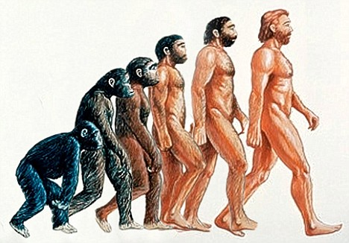
Evolution
What do you think of when you think of evolution?
Write down a few of your thoughts on EVOLUTION and what it means to you.
Evolution of life video

Slide 2
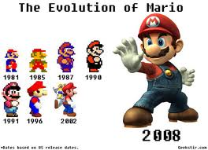
The Evolution Theory is the foundation on which the rest of biological science is built.
It is the process by which modern organisms have descended from ancient organisms.
Video

Slide 3
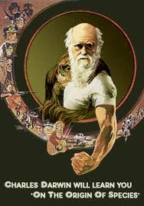
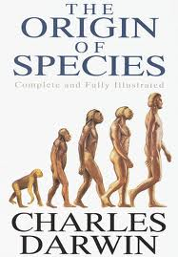
You could say that the evolution theory is both fact and theory.
For example, it is a fact that organisms have changed over time which is documented in the fossil record.
Many aspects of Darwin’s original theory have been revised. In this respect, evolution is indeed a theory.

Slide 4
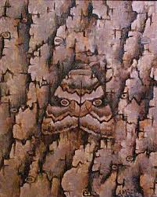
Adaptation is the process that enables organisms to become better suited to their environment.
Compare
&
Contrast
these two
terms

Slide 5
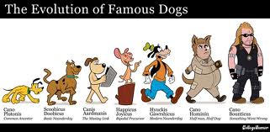
Both Evolution and Adaptation are about changes over time.
Adaptation can take a generation.
Evolution takes millions of years.

Slide 6
Where does adaptation occur?
How does evolution occur?
What is the diversity of life?

Slide 7
Diversity – is the variety of different living things. The amount of diversity on this planet is staggering.
Scientists believe that of all organisms that lived on earth, more than 99% of them have become extinct.
(with a partner, make a list of one hundred different organisms)

Slide 8
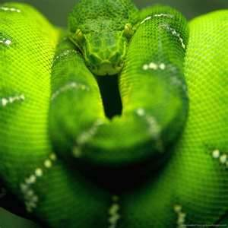
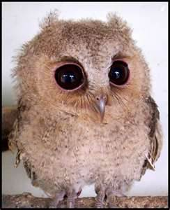
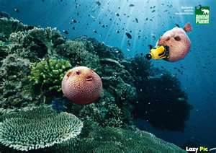
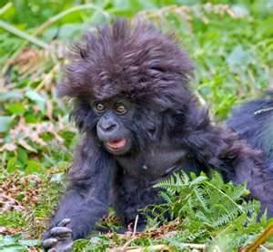
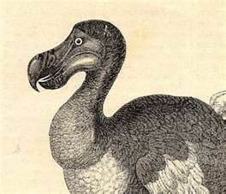
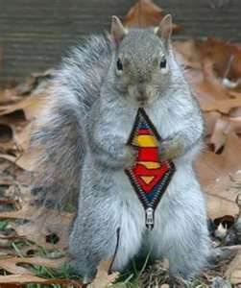
Did you have any of these animals on your list?

Slide 9
Much of what we know of ancient animals have come from fossil evidence.
Fossils
What are fossils? How are fossils made?
Give some examples of fossil evidence.
Scientists who study fossils are called?

Slide 10
Fossils are direct evidence of the past and help to assemble evolutionary history.
Fossils tell of major changes that have occurred.

Slide 12
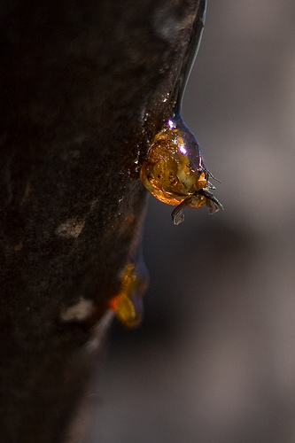
How Fossils Form
Animals were trapped in ice or snow fields, peat bogs, tar pits; insects were trapped in sap
Material surrounding them protected them from decay
Most fossils are found in sedimentary rocks
Organisms are embedded in sediments, and petrified (ie. Turned into rock)

Slide 13
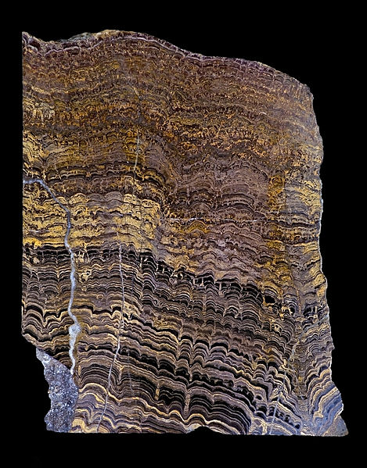
Sedimentary Rock
Rock that forms when grains of eroded rock (from weathering) and other materials are carried to the bottom of a body of water, and built up (under pressure) into layers

Slide 14
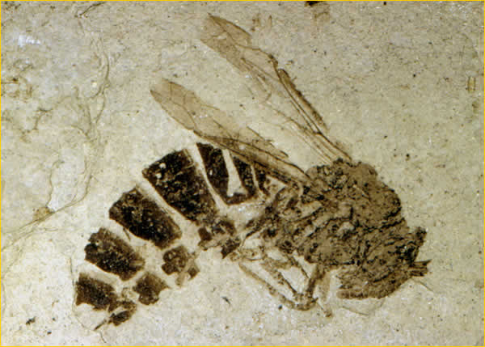
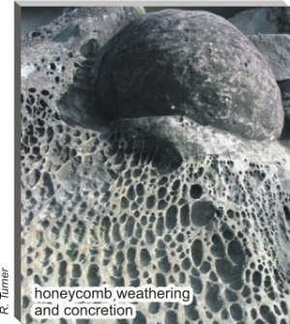
Fossil Evidence and Problems with the Fossil Record:
Not all organisms form fossils (eg. Soft parts will not fossilize as well as hard parts, less fossils of mountainous or desert organisms)
Finding fossils is difficult (especially in rocks)
Some sedimentary rocks wear down in weather and expose fossils ie. Grand Canyon
Quality of fossils vary

Slide 15
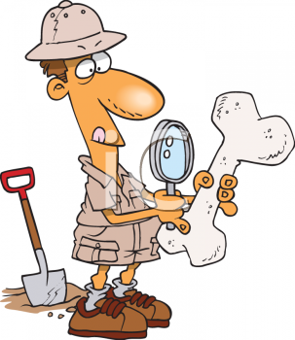
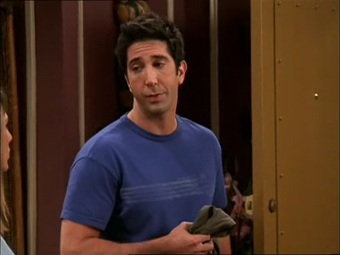
Paleontologist
Are scientists who study fossil

Slide 16
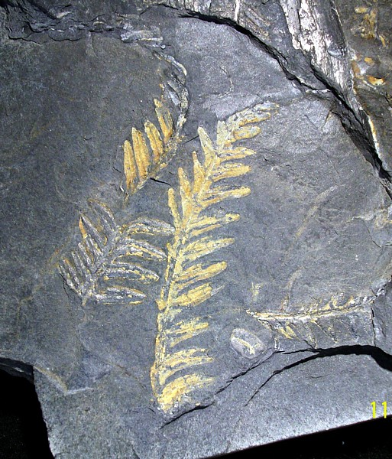
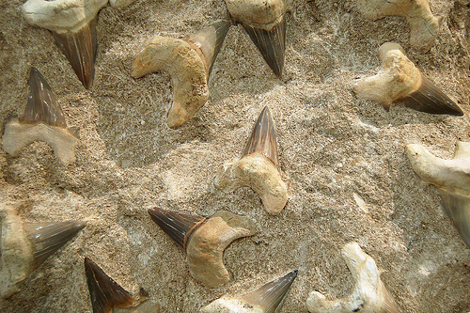
Fossil Record
Collection of fossils that represents the preserved collective history of the Earth’s organisms
Millions of fossils make up fossil record and tell us what/how things have changed in earths climate and geography
ie shark teeth in Arizona desert tells us there use to be seas there
Tropical ferns in Canada show that Canada was once much warmer

