Slide 1
Intro to Plants
Plants are multicellular eukaryotes that have cell walls made of cellulose. They develop from multicellular embryos and carry out photosynthesis using green pigments chlorophyll a and b.

Slide 2
What plants need to survive:
Sunlight-photosynthesis
Water and Minerals
Gas exchange-oxygen & carbon dioxide
Movement of water and nutrients

Slide 3
Seed Plants!
Notes:
Ask what are examples of seed plants

Slide 4
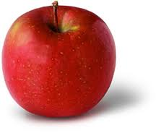
Seed Plants

Slide 5
Seed Plants
Divided into two groups:
Gymnosperms
Bear seeds directly on surface of cones.
Angiosperms (flowering plants)
Bear seeds within a layer of tissue that protects the seed.

Slide 6
No water needed
Life cycle alternates between gametophyte and sporophyte stage.
But they do not require water for fertilization of gametes (unlike mosses & ferns)
Can live just about anywhere
Moist habitats- dominated by seedless plants
Cold habitats-most seedless plants cannot survive

Slide 7
How have plants adapted to reproduce without water?
Flowers & Cones
The transfer of sperm by pollination
The protection of embryos in seeds

Slide 8
Cones & Flowers
Gametophytes of seed plants grow and mature with sporophytes called cones (gymnosperms) and flowers (angiosperms)

Slide 9
Pollen
The entire male gametophyte is contained in a tiny structure called a pollen grain
The sperms produced do not swim but are carried to female reproductive structure by wind, insects or small animals
The transfer between male and female reproductive structures is called pollination.

Slide 10
Seeds
A seed is an embryo of a plant encased in a protective covering and surrounded by a food supply.
An embryo is diploid .
The seeds food supply provides nutrients to the embryo as it grows.
The seed coat surrounds and provides protection and keeps it from not drying out.

Slide 11
Gymnosperms
Most ancient surviving seed plant
Cone bearers- means “naked seed”
Types:
Conifers
Pines, spruces
Cycads
Ginkgoes
Gnetphytes

Slide 12
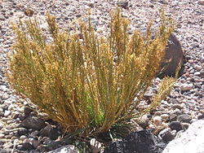
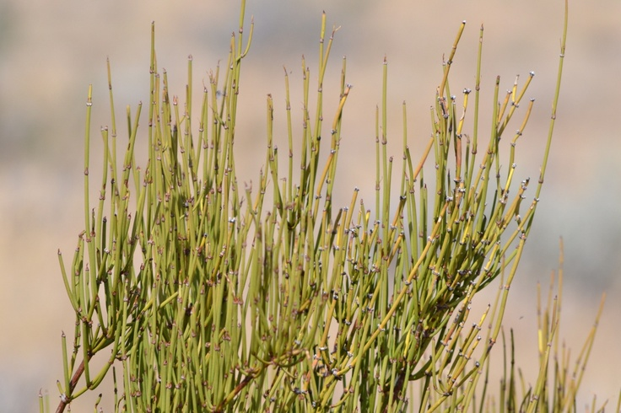
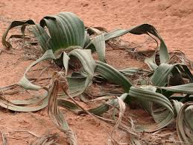
Gnetophytes
Phylum- Gnetophyta
Almost 70 species

Slide 13
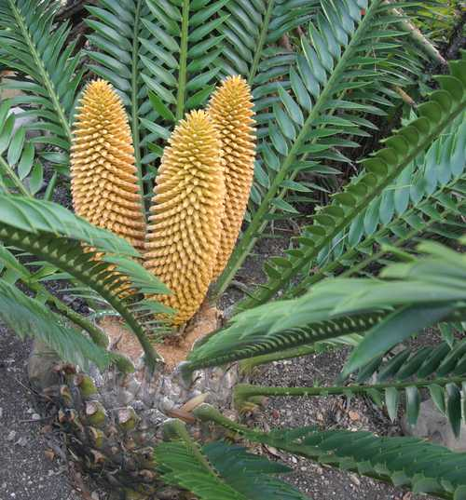
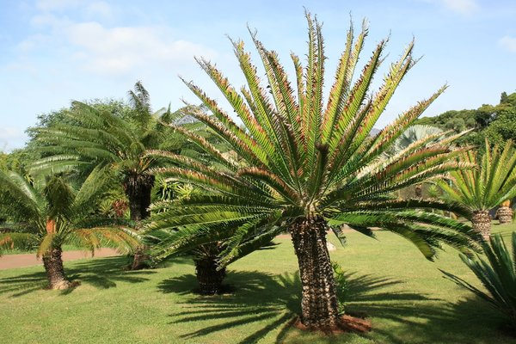
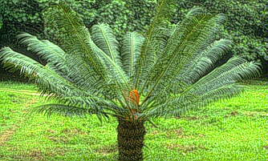
Cycads
Phylum- Cycadophyta
Palm like plants that reproduce with large cones.

Slide 14
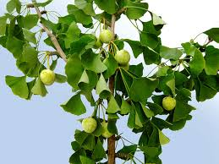
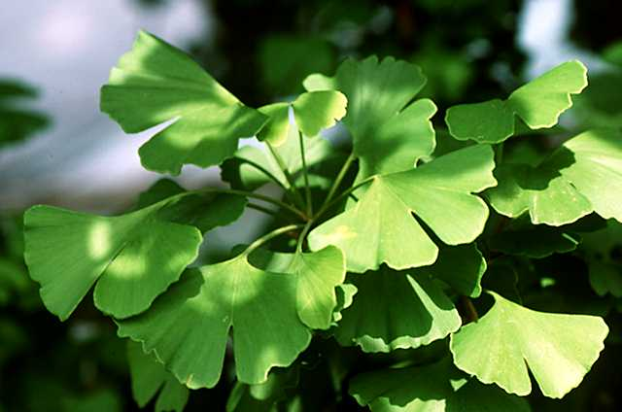
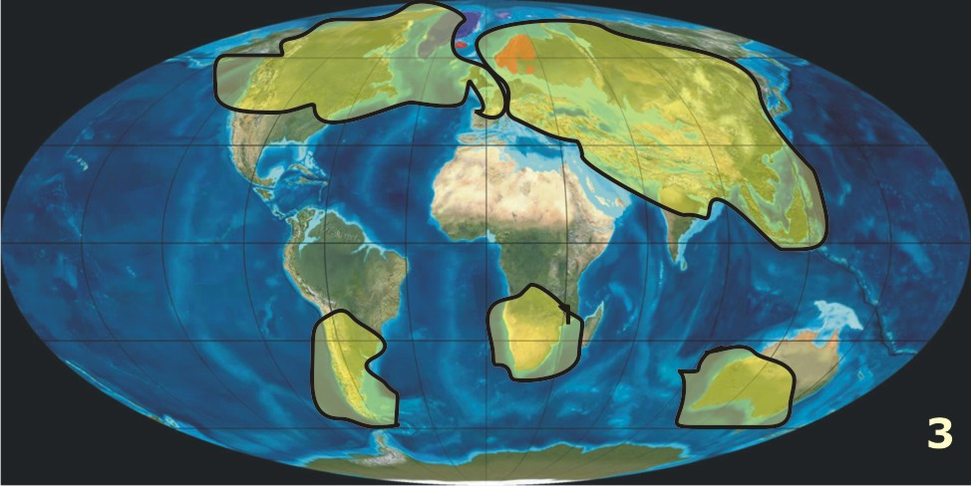
Ginkgoes
Phylum- Ginkgophyta
Were common when dinosaurs were alive, but today there is only one species- Ginkgo biloba

Slide 15
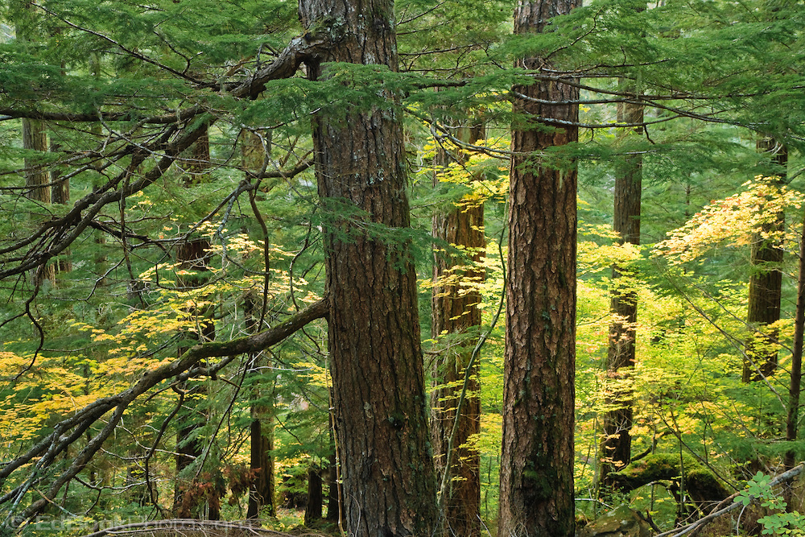
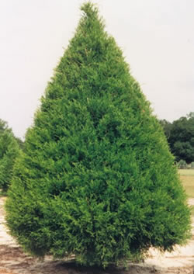
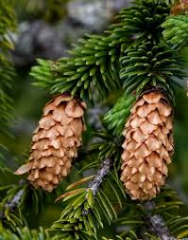
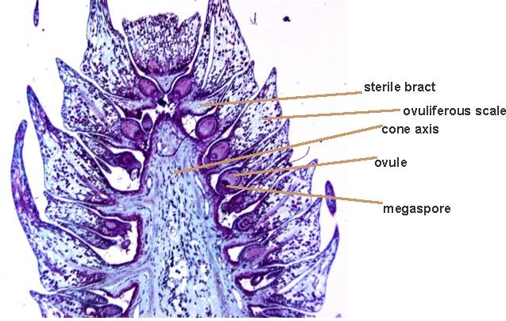
Conifers
Phylum- Coniferophyta
Most common gymnosperm
500 known species including pines, spruces, firs, cedars, junipers.

Slide 16
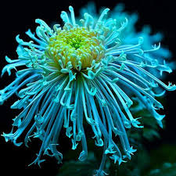
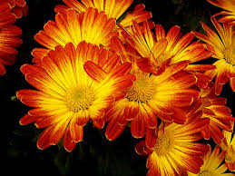
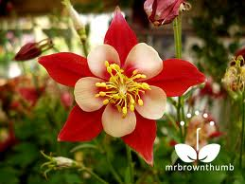
Angiosperms (flowering plants)
Phylum- Anthophyta
135 million yrs ago making them the most recent origin of all plants

Slide 17
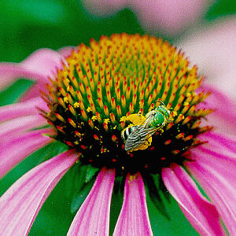
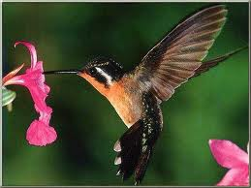
Angiosperms
Reproductive organs known as flowers
Evolutionary advantage because they attract animals such as bees, moths, hummingbirds.
Transport pollen from flower to flower, much more efficient then wind dispersal.

Slide 18
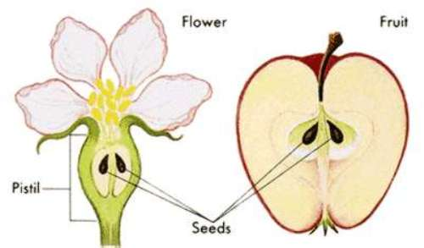
Contain ovaries
Surround and protect the seeds.
The ovary gives angiosperms their name meaning “enclosed seed”.
After pollination the ovary develops into fruit and protects and aids in dispersal.

Slide 19
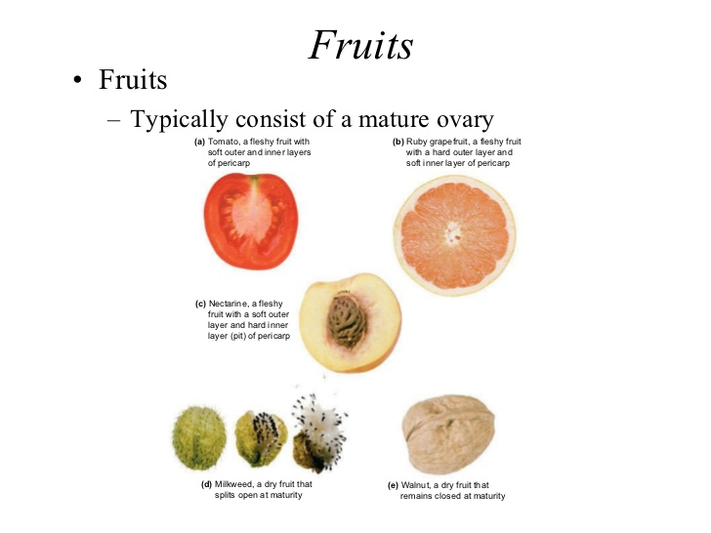
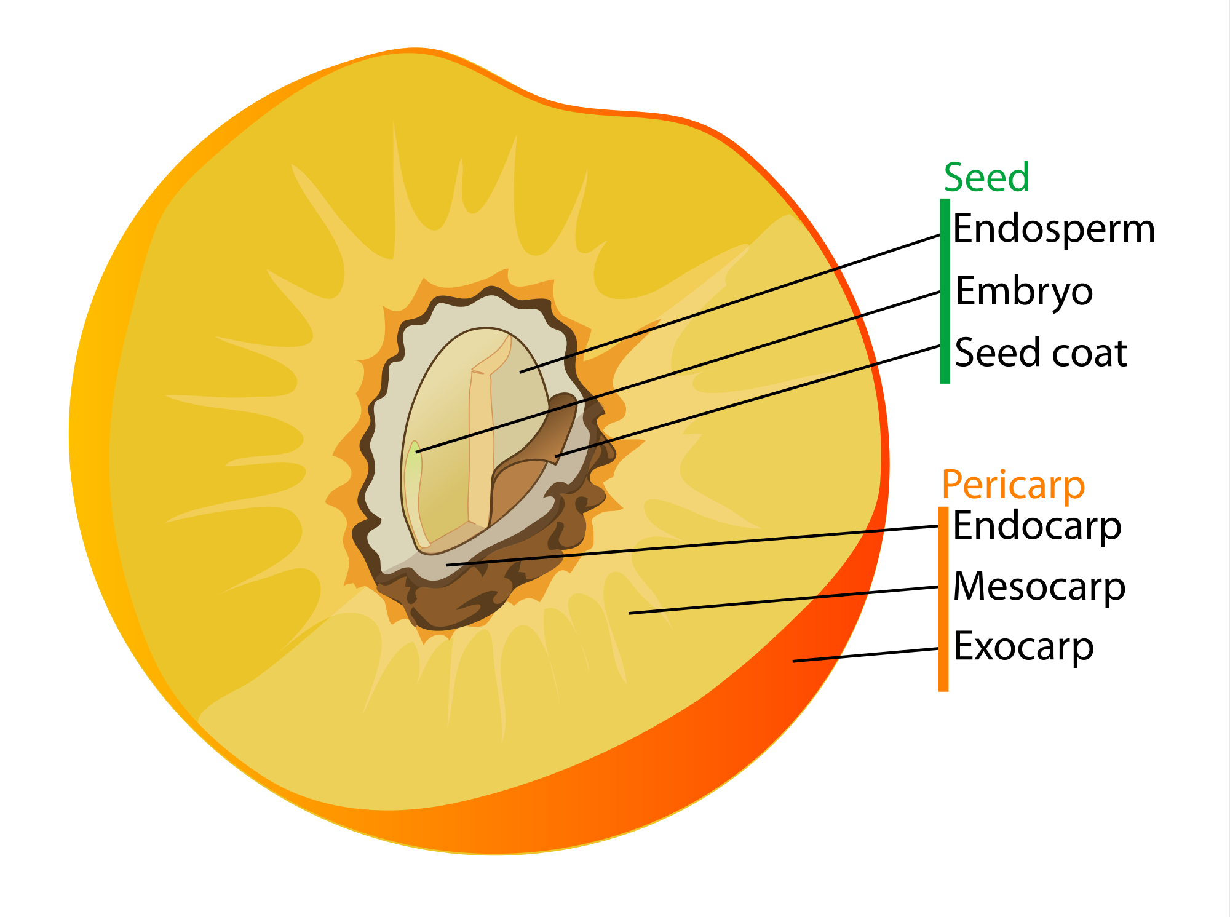
Fruit
Fruit is the wall of tissue that protects the seed
By using fruit to attract animals, flowering plants increase their ranges that they inhabit.

Slide 20
Diversity of Angiosperms (ways of categorizing)
Monocots & Dicots
Woody & Herbaceous plants
Annuals, Biennials & Perennials

Slide 21
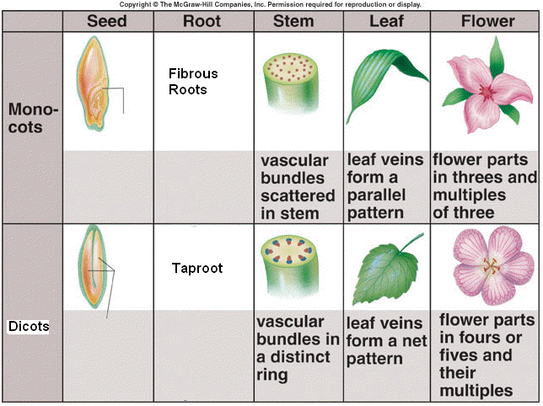
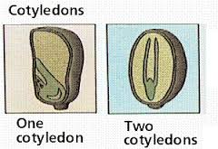
Monocot vs Dicot
Monocots- single cotyledon
Dicot- two cotyledon
Cotyledon is the first
leaf or pair of leafs
produced by the
embryo of a seed
plant
Monocot examples-
corn, wheat, lilies,
orchids, palms.
Dicot examples-
roses, clover,
tomatoes, oaks,
daisies.
Montyledn ocot single co

Slide 22
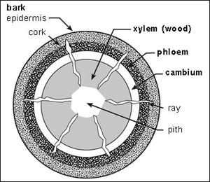
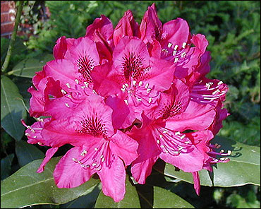
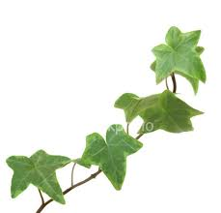
Woody vs. Herbaceous plants
Woody- made primarily of cells with thick cell walls that support the plant
examples- tree’s, shrubs, and vines
examples of vines- grapes, ivy.
examples of shrubs- blueberries, rhododendrons, and roses

Slide 23
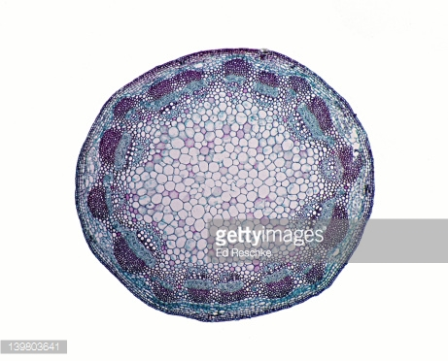
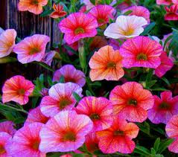
Woody vs. Herbaceous plants
Herbaceous- plant stems that’s are smooth and non-woody
do not produce wood as they grow.
examples- dandelions, zinnias, petunias, and sunflowers

Slide 24
Annuals, Biennials and Perennials
How long can flowers last in a garden?
Some grow, flower, die in a year, others can continue to grow from year to year.
There are 3 categories of plant life spans

Slide 25
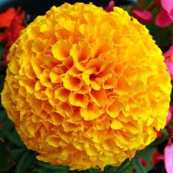
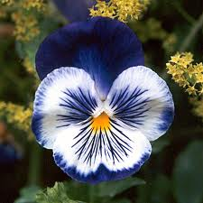
Annuals, Biennials and Perennials
Annuals-flowering plants that complete a life cycle within one growing season.
Examples- merigolds, petunias, pansies, and zinnias

Slide 26
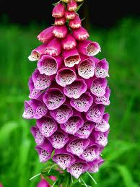
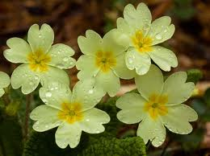
Annuals, Biennials and Perennials
Biennials-angiosperms that complete their life cycle in two years.
1st yr they germinate, and grow roots, very short stems,
2nd yr they grow new stems and leaves and produce flowers and seeds. Once seeds are produced the plant dies.
examples are primrose, parsley,
celery, and
foxglove.

Slide 27
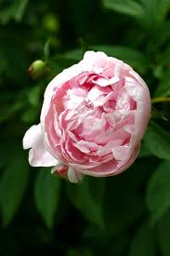
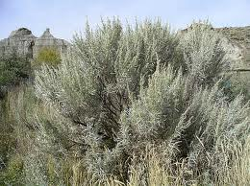
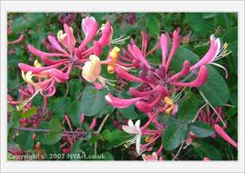
Annuals, Biennials and Perennials
Perennials-live longer than 2 yrs
Some such as peonies, asparagus and many grasses have herbaceous stems that die each winter and replaced in the spring.
Most have woody stems like palm trees, sagebrush, maple trees, and honeysuckle

Slide 28
Ch 22 Assessment pg. 575-576
Questions 8-10, 21-25, 35

Slide 29
Review Questions:
Seed plants are divided into what two groups?
Angiosperms are described as what kind of “seed”? Gymnosperms are described as what kind of “seed”?

Slide 30
Review Questions:
Name the one species from the Phylum- Ginkgophyta.
By using to attract animals, flowering plants increase their ranges that they inhabit.

Slide 31
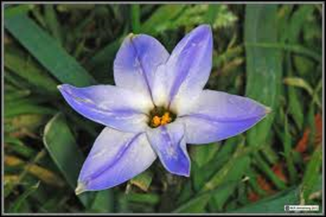
Review Questions:
Is this flower monocot or dicot and why?
Dicots have what kind of a root?
Monocots have what kind of veins in their leaves?

Slide 32
Review Questions:
Name one kind of annual flower
How long do Perennials live for?

