Slide 1
Platyhelminthes
Notes:
Might be a little long for 1 page

Slide 2
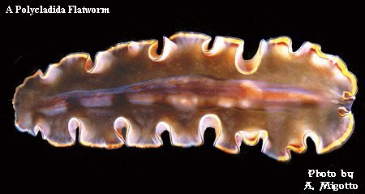
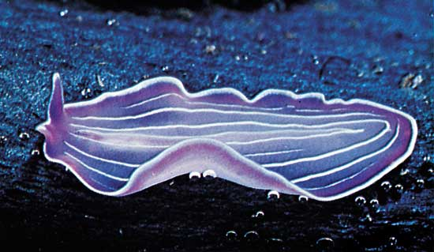
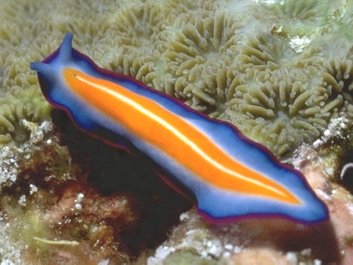
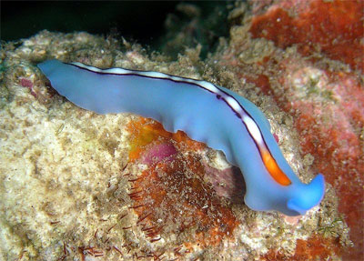

Slide 3
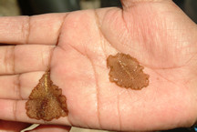
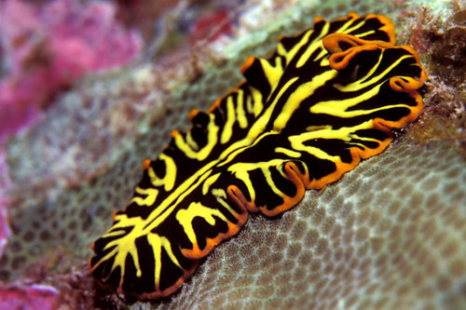

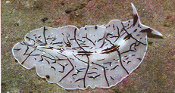
Phylum Platyhelminthes
They are flatworms
You mean they are ACTUALLY flat?!?!

Slide 4
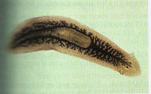
Examples
Class Turbellaria
  Planarians; free-living
Notes:
https://www.youtube.com/watch?v=2NvFC-qyatU

Slide 5
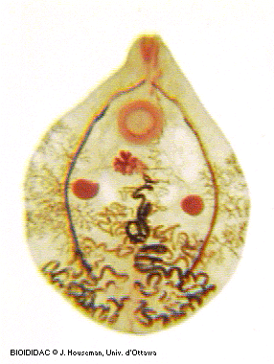
Examples
Class Trematoda
  Flukes
  Parasitic flatworms

Slide 6

Examples
Class Cestoda
  Tapeworms
  Parasitic

Slide 7
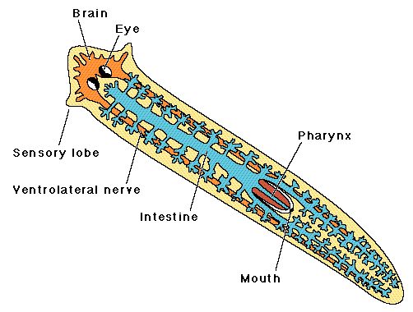
Body Structure
Notes:
Brain (ganglia) - planarian can process information about their environement
Pharynx - used for suckling food in (the mouth is at the end of the pharynx)
Eyespot - simple eye, can detect light
Flame cells - located along the lateral edges, used for excretion
Intestine - digestion (does not have an anus)
Parasitic – relies on host, so may/not have eyespot. Will have simpler digestive system.

Slide 8
Feeding
Free-Living
Parasitic
Mouth → pharynx →gastro. Cavity → intestines
Suck with pharynx
Simpler digestive system
Tapeworms: no digestive tract; absorb via diffusion!

Slide 9
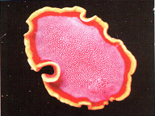
Respiration
Via diffusion (parasitic only), sometimes through flame cells
Notes:
Via diffusion because so thin and flat!
Flame cells function like a kidney, removing waste materials. Bundles of flame cells are called protonephridia

Slide 10
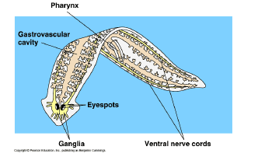
Nervous
Free-Living
Parasitic
Head with ganglia (small, central bundle of nerves)
May have
eyespot
No brain
May have eyespot

Slide 11
Movement/Reproduction
Free-Living
Parasitic
Cilliated epidermal cells help to glide
Muscles controlled by nervous system
Asexual & sexual
No need to move – host provides steady nutrient source
Sexual
Often 2 phases – host and free-living

Slide 12
Penis Fencing ☺
https://www.youtube.com/watch?v=wn3xluIRh1Y
The flatworms "fence" using two-headed dagger-like penises which are pointed, and white in color. The mating ritual involves a violent battle during which two hermaphroditic flatworms attempt to pierce the skin of one another with one of their penises. The "winner" is the organism that inseminates the other; the winner becomes the father. The sperm is absorbed through pores in the skin, causing fertilization in the "loser," who becomes the mother

Slide 13
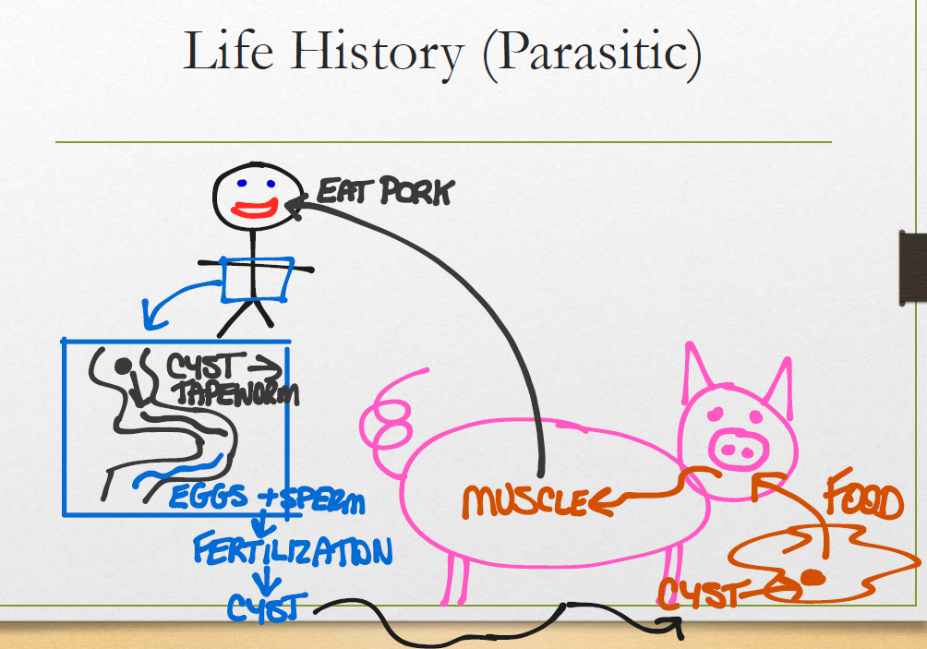

Slide 14
Questions
What are at least 3 ways flatworms are more complicated than Cnidarians?
How does the shape of the flatworm allow it to rely on diffusion for respiration?
What are the 3 groups of flatworms? Which ones are free-living?
Why is internal fertilization important!?
Why does it take more energy for the “female” to reproduce?

