Slide 1
Kingdom Plantae
Non Vascular Plants Vascular Plants
Algae Moss Ferns
Angiosperms
Gymnosperms
Red Green Brown

Slide 3
Adaptation to land

Slide 4
What is a plant?
- multicellular eukaryotes
- Possess cellulose-rich cell walls, store starch
- develop from multicellular embryos
- photosynthesis using chlorophyll a, b and carotenoids

Slide 5
How do they survive?
Sunlight = photosynthesis
Water and Minerals
Gas Exchange- 0xygen and CO2
Movement of water and Nutrients

Slide 6
TERRESTRIAL (LAND) PLANTS
Land plants are divided into two groups:
Phylum Bryophyta
Nonvascular plants
Examples: Mosses, liverworts, hornworts
Phylum Tracheophyta
Vascular plants
Examples: ferns, shrubs, herbs, trees, flowering plants

Slide 7
VASCULAR VERSUS NONVASCULAR PLANTS
VASCULAR PLANTS
Have a vascular system (“plumbing” system) that transports
water, nutrients, and sugars throughout the plant.
Consists of two types of tissues:
Xylem
Vascular tissue that carries water and minerals upward from the roots to the leaves.
Phloem
Vascular tissue that transports food (sugar) made in the leaves, throughout the plant.
NONVASCULAR PLANTS
Lack a vascular tissue and must rely on diffusion for transport.

Slide 8
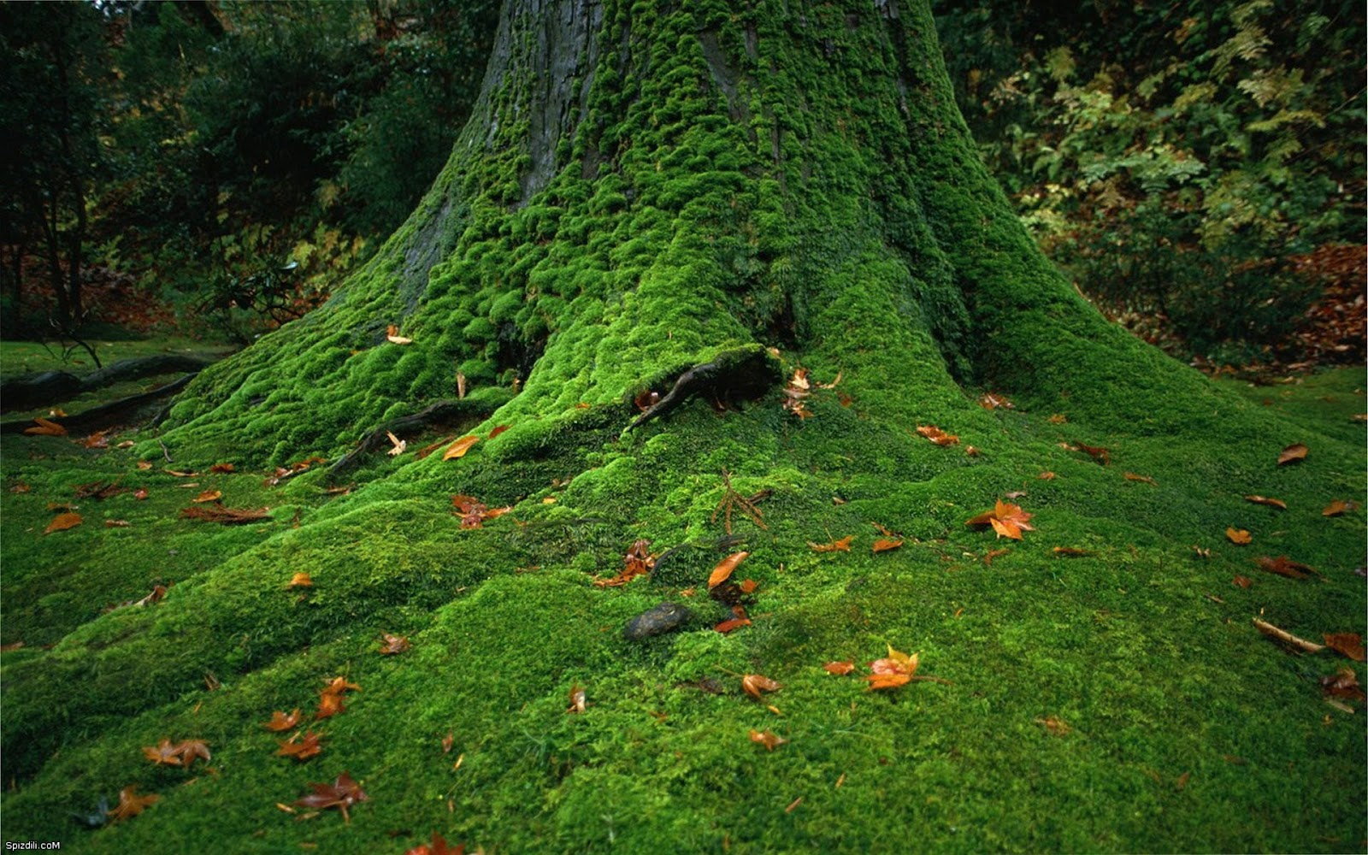
Bryophytes
Mosses

Slide 9
What do you notice about bryophytes?

Slide 10
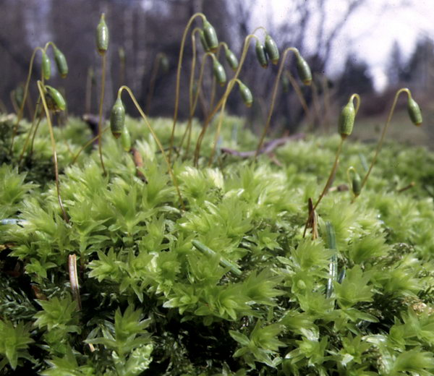
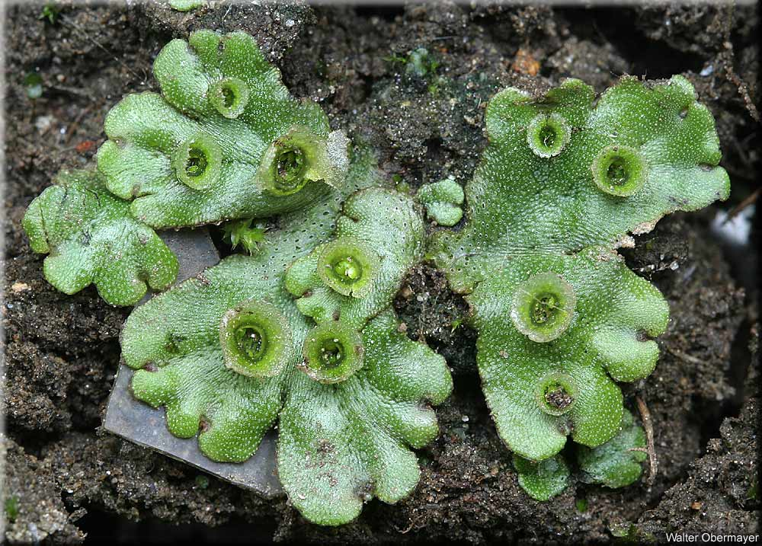
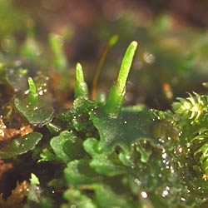
Bryophytes
Includes Moss, liverworts, hornworts

Slide 11
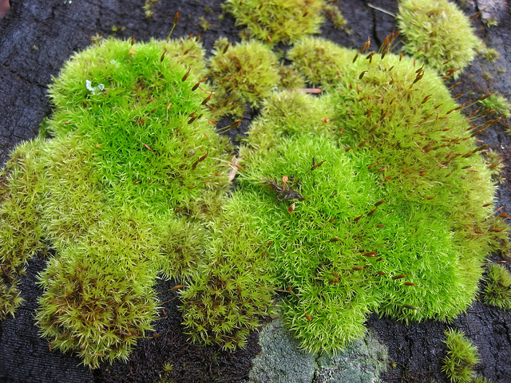
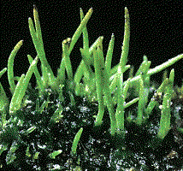
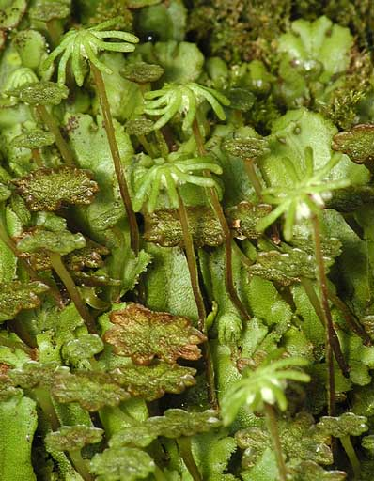
Mosses Hornworts Liverworts
Moss Hornworts Liverworts
(Bryophyta) (Hepatophyta) (Anthocerophyta)
(video)

Slide 12
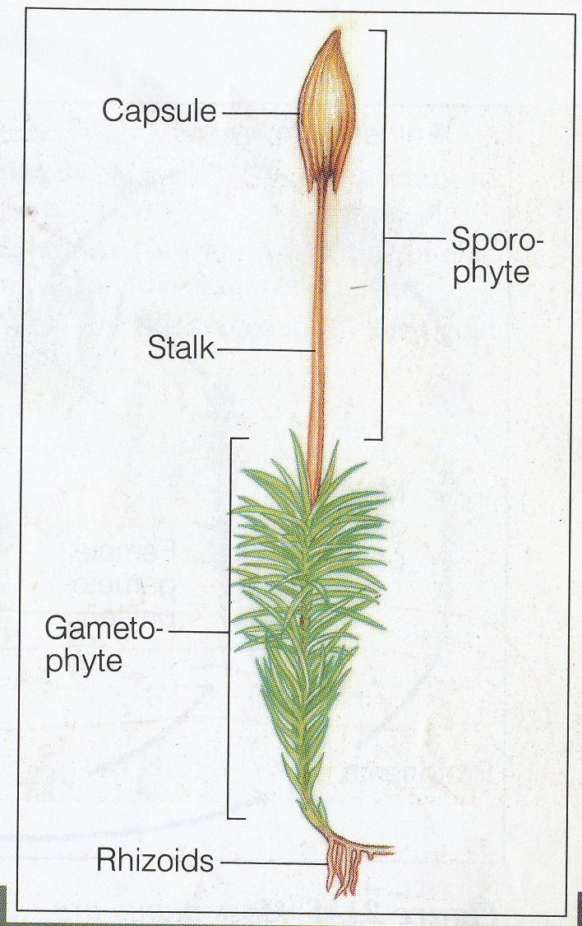

Slide 14
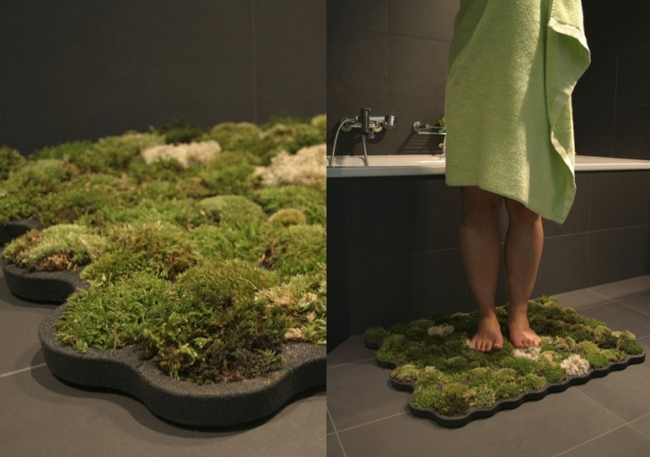
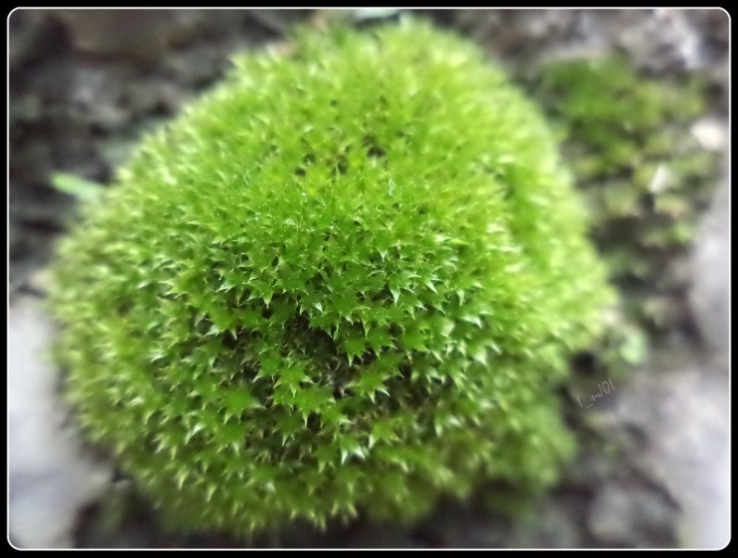
Bryophytes
First land plants!
More complex then algae
No vascular system
Need damp, cool environment
Notes:
Mnium; marchania [gemmae cups!]; hornwort - like liver wort but diff’t sporophyte

Slide 15
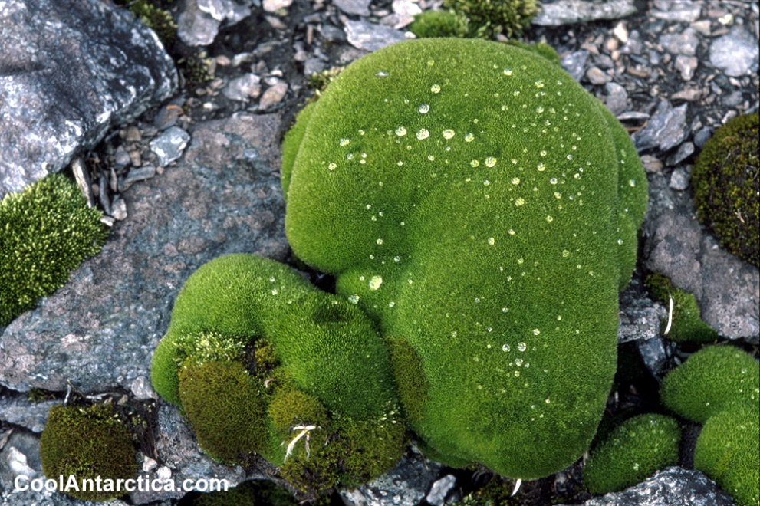
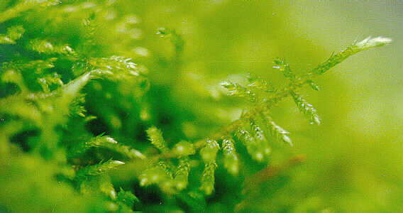
Key Characteristics of Mosses
Chlorophyll a and Chlorophyll b
Small stature due to a lack of vascular tubes to transport water and nutrients.
No Cuticle to prevent water loss
Flagellated sperm cells need water to move to eggs
Reproduction: Exhibit Pronounced Alternation of Generations

Slide 16
Bryophyte Habitats
Require moist environments for at least part of the year (to allow for reproduction).
Can only thrive in wet areas (swamps, marshes, near streams)
Thrive in temperate and tropical rain forests.

Slide 17
Moss Common in Riparian Areas

Slide 18
Rain Forests

Slide 19
Ecological role
Mosses are pioneer plants, and establish themselves on exposed rock or soil surfaces where there are no plants.
They enrich the soil as they die and build organic content that leads to soil formation.
Mosses form peat (heating fuel),
possess antiseptic properties (low pH)
clean up oil spills.

Slide 20
“For Peat’s Sakes”
Many species of moss belonging to the genus “Sphagnum” are called Peat Mosses. A substance called “Peat” is made of incompletely decomposed peat moss remains, which accumulate in waterlogged soils over thousands of years. The natural processes of decay are prevented by water logging, acid production and oxygen depletion.

Slide 21
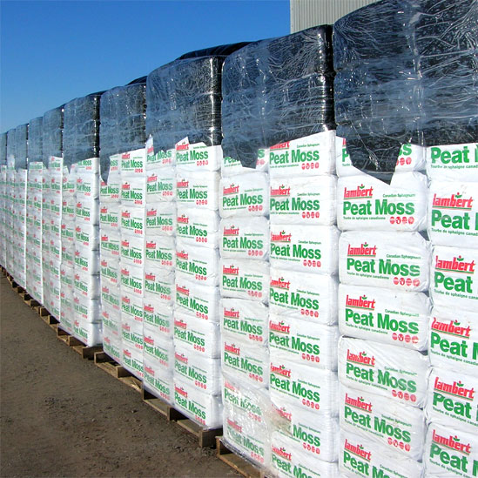
Over 350 Species of Sphagnum
Overlapping “leaves” very effective in absorbing water, absorb up to 20 X their own weight in water. In comparison cotton swabs can only hold 4-6 X their own weight.
Tops of Sphagnum moss with sporophytes

Slide 22
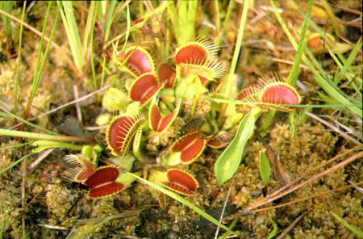
Peat bogs are Unique Habitats
Peat bogs are fragile ecosystems, where many highly adapted plant and animal species live. Peat land plants are highly specialized to survive in these poor N₂ depleted soils. Certain mosses and carnivorous plants survive only on peat bogs.

Slide 23
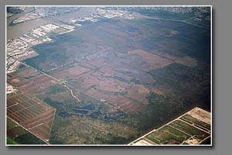
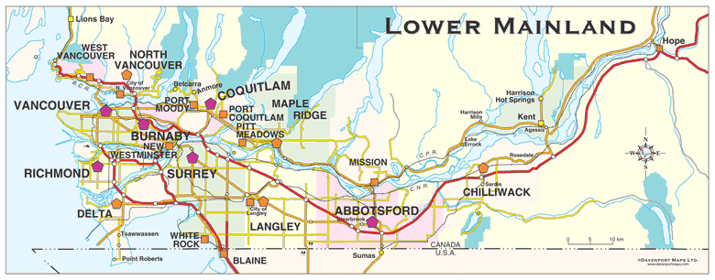
BURNS BOG – DELTA - BC
The largest raised peat bog on the west coast has recently been protected from development, but only after much of the natural vegetation has been altered by human activities.

Slide 24
Peat is Used Commercially
Primarily as growing medium in the horticultural industry. Harvesting of peat has destroyed most of the natural bogs in the Britain and N Europe (>80%).
Used historically as a source of fuel in Northern Europe and an antiseptic and absorbent by many cultures. Widely used in the 1st World War to treat injuries.

Slide 25
Reproduction: Life Cycle of a Moss:
Mosses have a life cycle that involves spores rather than seeds.
Both sporophyte and gametophyte stages exist on the same plant.
Mosses undergo AOG

Slide 26
Sexual Reproduction of Moss
Haploid spores (n) are produced by meiosis in the sporangium capsule (2n) and are released into wind or water.
Protonema (n) forms after a spore germinates & undergoes mitosis, and resembles a filamentous green algae.
The protonema (n) forms a small gametophyte plant consisting of root-like rhizoids, shoots & green leaflets.
Mature gametophyte plant develops sex organs at its tip.
Antheridium = male sex organ, produces sperm cells (n).
Archegonium = female sex organ, produces eggs (n).
Fertilization occurs when plant is wet so sperm can swim to the egg (n + n) and a zygote (2n) develops.
Zygote (2n) develops into a sporophyte plant (2n) consisting of a stalk & sporangium.
video

Slide 27
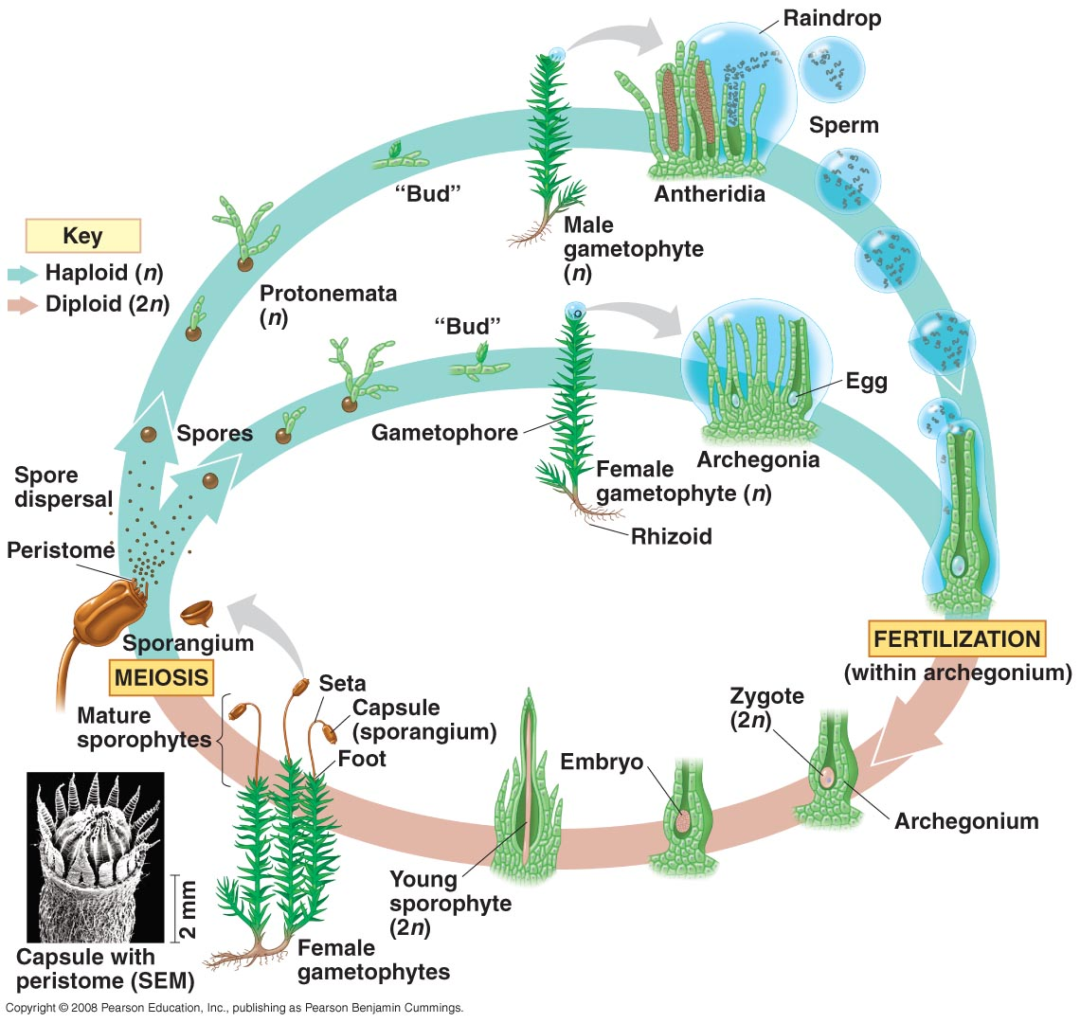

Slide 28
Asexual Reproduction of Mosses:
1) fragmentation - parts breaking off the plant.
2) gemmae - small, disk-like bodies made by gametophytes.

Slide 29
