Slide 1
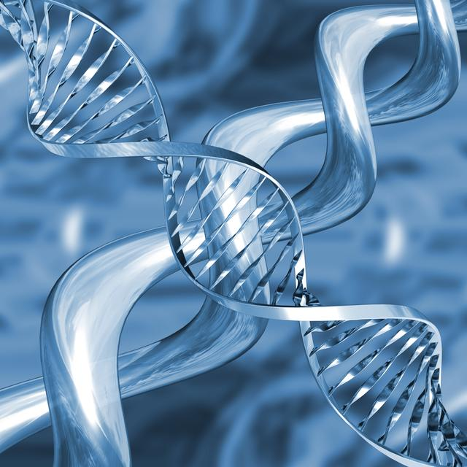
DNA – The Double Helix

Slide 2
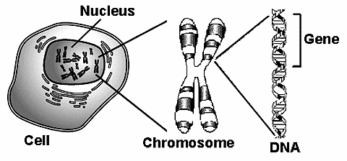
DNA - Chromosomes
A chromosome is essentially a single DNA molecule.
DNA stands for "deoxyribonucleic acid”, a term which describes the type of sugar (deoxyribose) and the location in the cell (nucleus).

Slide 3
Nucelotides
The building blocks of DNA are "nucleotides" which are attached together like a twisted ladder to form a “double helix”.
Stores & transmits genetic information from one generation to next
DNA is a polymer. The Monomer Units of DNA are nucleotides.

Slide 4
DNA is located in a gene which is found in every living cell. It is what creates new daughter cells from a mother cell.
This process is called meiosis or mitosis.

Slide 5
DNA
Controls the production of proteins (the building blocks of an organism)
Ex: skin, hair, hormones, cell parts etc
DNA determines which proteins, when, and how many at one time

Slide 6
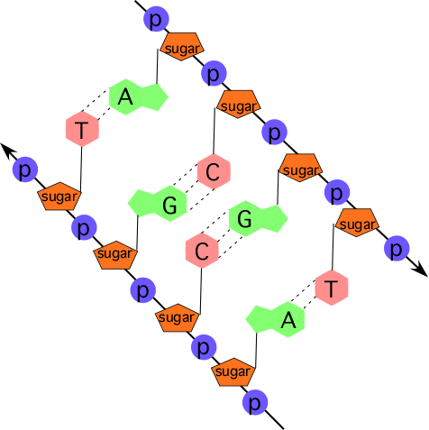
Nucleotide Units
DNA is a long molecule made up of units called nucleotides.
Nucleotide are made
up of three basic
components;
phosphate, sugar, and
a nitrogen base.

Slide 7
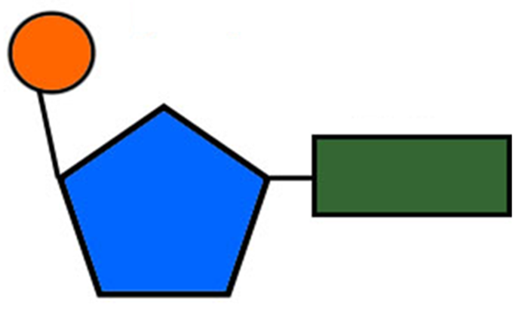
There are four different kinds of bases so there are four different kinds of nucleotides:
Purines: A = Adenine and G = Guanine
Pyrimidines: T = Thymine and C = Cytosine
Base Pairing, is Specific, and always occurs between a Purine and a Pyrimidine.
Specifically A-T and C-G, This is because of the hydrogen bonding that occurs between these pairs of nucleotides.

Slide 8
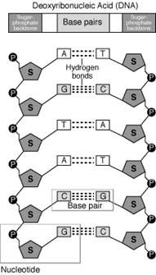
There are millions of bases in 1 DNA strand!!
The specific sequence is important
The uprights of a DNA "ladder" are formed by the phosphates and deoxyribose units (Sugar). Each rung of the "ladder" is formed of two bases joined by hydrogen bonds. These bonds actually hold the two strands of DNA together.

Slide 9
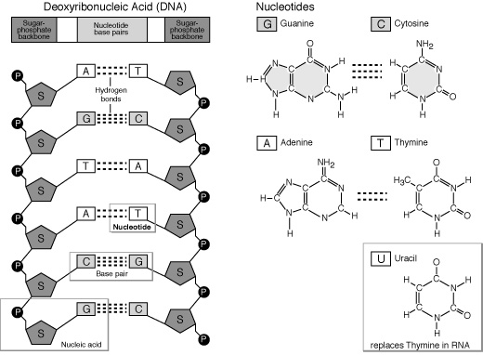

Slide 10
So What’s the Point?
All living things have the DNA with the same 4 nucleotides, and the same structure as well as the same “code” for the amino acids that are the monomers for the polymer proteins they make.

Slide 11
In Human this time
DNA is the brains of every cell because it contains all of the genes that are the codes for making proteins. Proteins are the structural components and catalysts for essentially everything your cells do, and therefor what you do.
DNA has two major purposes:
DNA REPLICATION & PROTEIN SYNTHESIS
Video

Slide 12
Vocab
Chromosome
genetic code
Protein
nitrogenous base
complementary base pair
DNA

Slide 13
Activity
DNA colouring

