Slide 5
Classification
Everyday, people organize and group things to avoid confusion between objects, ideas, and events. These are forms of classification.
Life could become more difficult without classification systems. What would it be like trying to find a phone number in the directory without an alphabetical listing, or trying to find a house without street or house numbers?

Slide 6
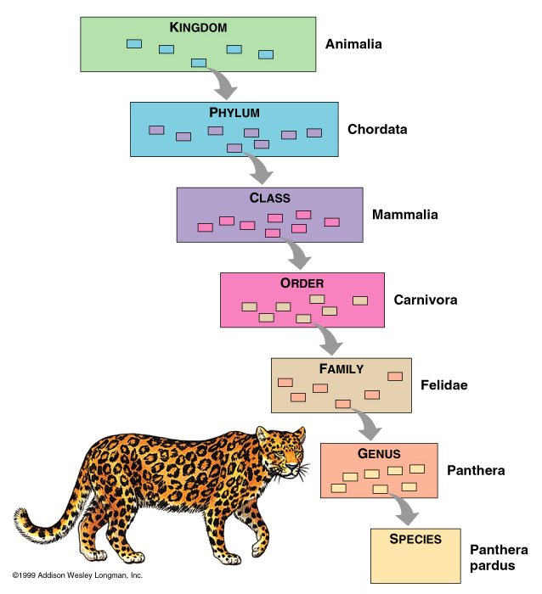
Classification is a major field of biology. The science of classifying organisms is called Taxonomy. Scientists who work in this field are known as Taxonomists.

Slide 7
There are two main purposes for biological classification;
Identifying organisms
Providing a basis for recognizing natural groupings of living things. They place organisms into groups that have real biological meaning (i.e. share important traits).
Classification systems are artificial. They are developed to aid in dealing with the diversity of life and representing relationships among organisms.

Slide 8
Carolus Linnaeus (1707-1778)
was credited with devising the biological classification which is based on an organisms physical and structural features. The more features in common, the closer their relationship.
The rules for assigning names to plants and animals was first used by Linnaeus and is called binomial nomenclature. For this system, each organism is given a two-part Latin name which is known as its scientific name.

Slide 10
The first part of the scientific name is called the genus
the second part is called the species.
A genus is a group of closely related species that look alike in many ways.
A species is just one kind of organism that can interbreed with one another.

Slide 12
RULES FOR WRITING SCIENTIFIC NAMES
1. The genus is always capitalized, while the species is not.
2. The two names are either underlined separately or in italics.
(ie) Humans - Homo sapien
Red Maple - Acer rubrum

