Slide 1
DNA
Replication

Slide 2
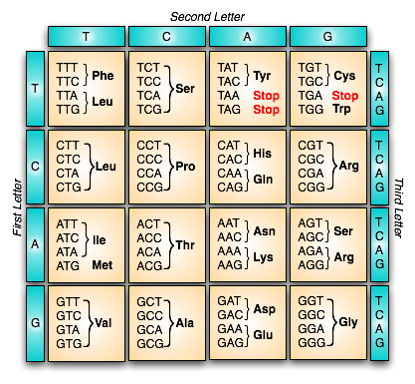

Slide 3
Replication
DNA is a self replicating molecule.
This means it can make copies of itself.

Slide 4
Replication
Process:
1. DNA unzips (H bonds between bases break).
2. New nucleotides bind to their complementary bases
3. New sugar phosphate backbones form.

Slide 6
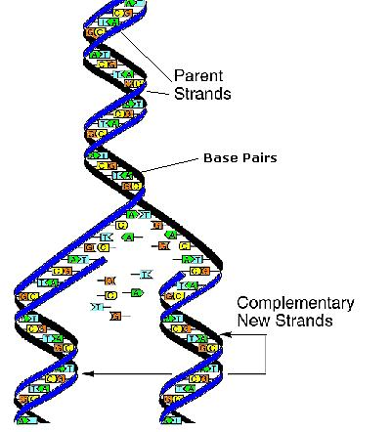

Slide 7
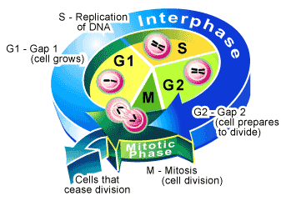
Replication
Importance:
When cells divide, they need a full set of chromosomes.
The DNA must be copied so that when mitosis occurs, there is a copy of DNA for each daughter cell.

Slide 8
Replication Animation
DNA Replication
2:15-4:30

Slide 9
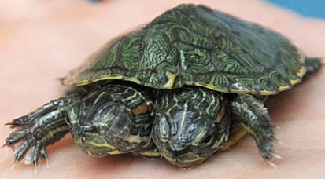
Gene Mutations
Gene Mutation: any alteration in the code of a single gene or any change in its expression.
mistakes during replication or environmental factors can cause a change in the genetic code
effects may be positive or neutral but are usually NEGATIVE.

Slide 10
Mutations (continued)
usually changes in one or more DNA nucleotides or an alteration in the sequence of nucleotides
results in incorrect transcription and translation
resulting polypeptide may be non functioning
affects protein functioning and can have a drastic effect on the normal functioning of the body

Slide 11
Types of Mutations
Based on the change:
Point Mutation
Frame-Shift Mutation
Based on the location:
Somatic Mutation
Germinal Mutation

Slide 12
Point Mutations
Change one base pair for another
also called SUBSTITUTION mutations
Example:
THE BIG DOG BIT TED AND RAN OFF...
THE BIG DOG BIT BED AND RAN OFF...

Slide 13
Point Mutations (effects)
may have no effect
GAT → GAC – both code for leucine
may result in a new amino acid in the polypeptide chain
CTT → CAT – valine replaces glutamate
(sickle cell anemia)
may result in a premature end to the polypeptide chain
AGT → ATT – serine replaced by STOP

Slide 15
Frameshift mutations
Add or delete a base; everything is shifted over
results in change to all codons after mutation
results in nonfunctional protein/enzyme due to altered codon sequence
Example (addition):
THE BIG DOG BIT TED AND RAN OFF...
THE BIG DOG BIT ATE DAN DRA NOF...
Example (deletion):
THE BIG DOG BIT TED AND RAN OFF...
THE BIG OGB ITT EDA NDR ANO FF...

Slide 16
Location of Mutation
Somatic
Germinal
In Normal body cells
Not passed onto offspring
in “germ”/reproductive cells (eggs, sperm etc)
Can be passed onto next generation

Slide 17
Good/Bad/Ugly?
DNA mutations are rare!
Molecules check base-pair match frequently
Usually random changes are HARMFUL
May be fatal
Not passed on to offspring
Some changes are “SILENT”
overall trait/effect is still the same.
Only passed onto offspring if germinal

Slide 18
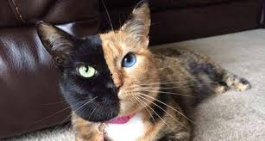
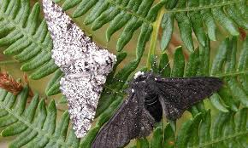
Good/Bad/Ugly?
Very rarely, a change might be BENEFICIAL
Might give them an advantage!
Only passed onto offspring if germinal

Slide 19
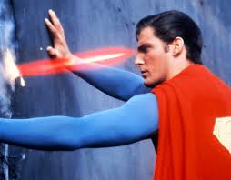
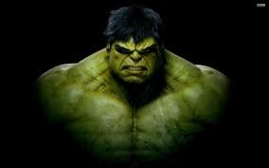
Mutagens
a mutagen is defined as any agent that causes mutations in humans
there are 2 broad categories
High Energy Radiation: x-rays, gamma rays, UV light
Chemical Mutagens: benzenes, dioxins, some substances in cigarette smoke

